Slide 1


Lesson 1: Add 10
www.arithmagicians.com

Slide 2

+10
+10
+10
+10
+10
+10
+10
+10
+10
10
20
30
40
50
60
70
80
90
100
Get ready to count up in 10s

Slide 3

?
10
20
30
40
50
60
70
80
90
100
What is the missing number?

Slide 4
?
10
20
30
40
50
60
70
80
90
100
What is the missing number?

Slide 5
?
?
10
20
30
40
50
60
70
80
90
100
What are the missing numbers?

Slide 6

10 + 10 =
20

Slide 7
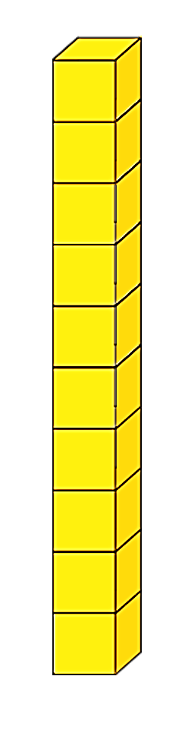
20 + 10 =
30
+
=

Slide 8
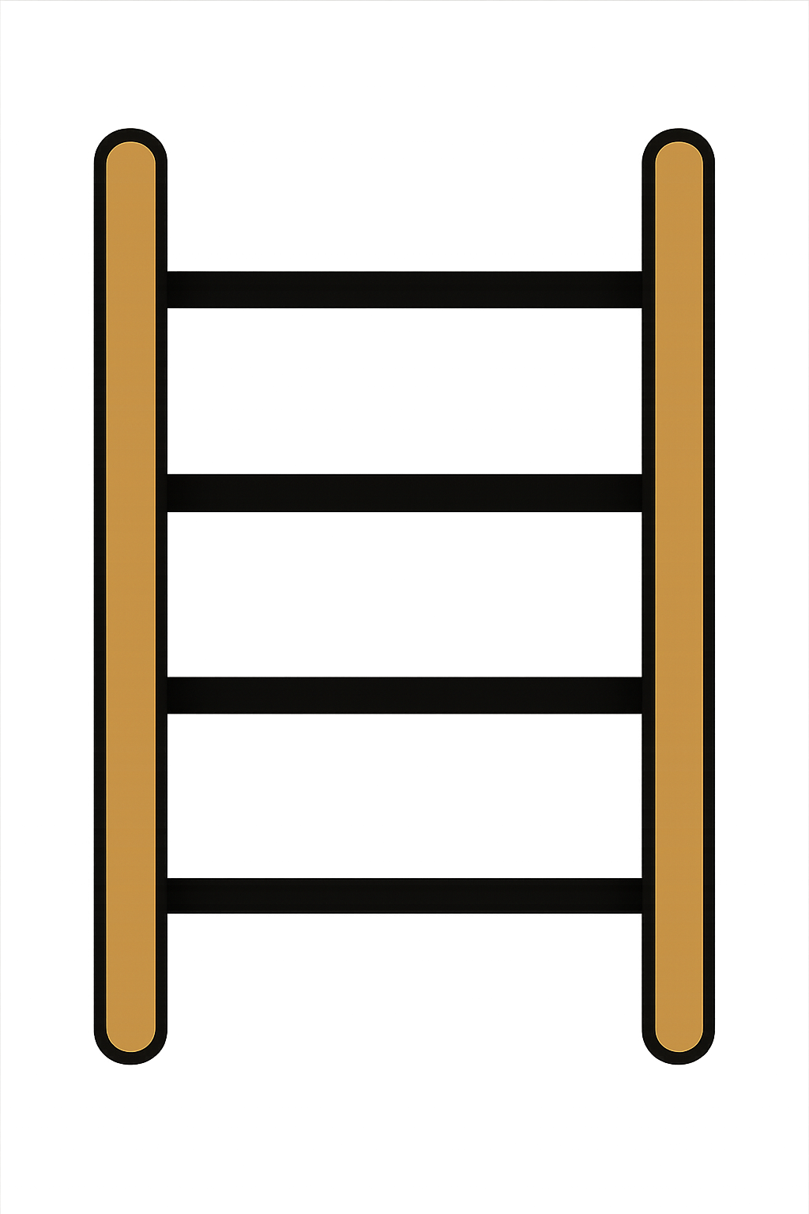
30 + 10 =
40

Slide 9
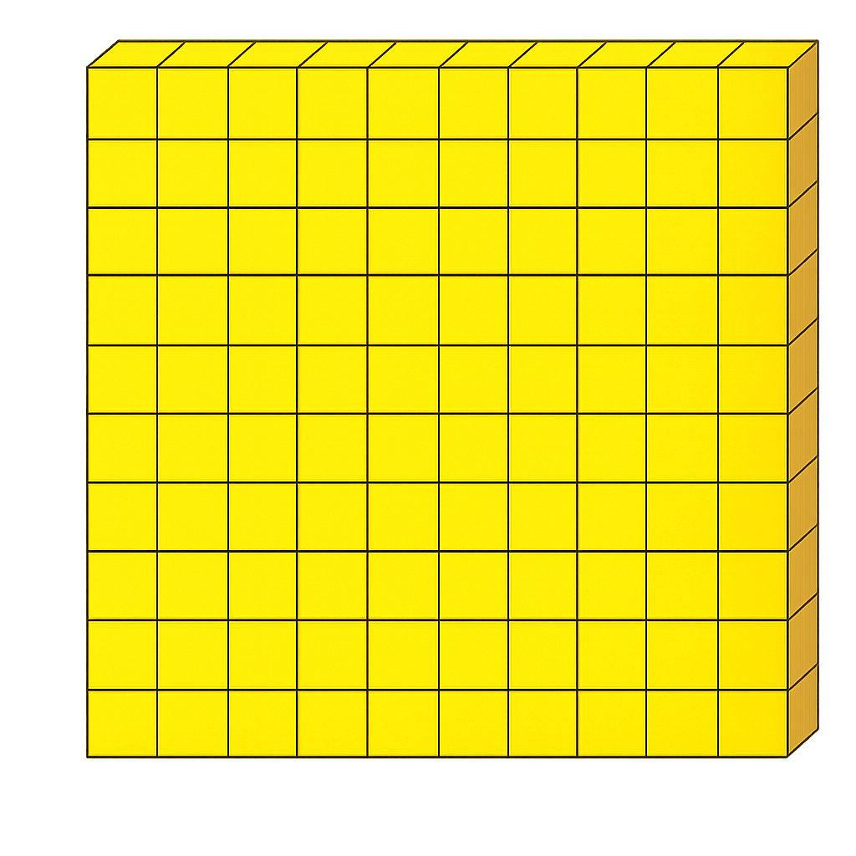
100
90 + 10
+

Slide 10

What do you notice?
20
+
10
=
30
70
+
10
=
80
When you add 10 to a number, the tens digit goes up by _____.
one

Slide 11


Your Turn
20
10 + 10 = ?
60
2) 50 + 10 = ?
3) 80 + 10 = ?
90
40
4) 30 + 10 = ?
5) 40 + 10 = ?
50

Slide 12
Always/Sometimes/Never
When we add ten to a number, the number stays the same.
Never

