Slide 1


Lesson 1:
Multiply by 10 & 100
www.arithmagicians.com

Slide 2

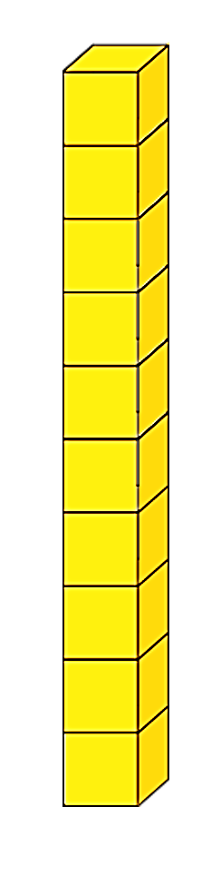

3
__ is ten times the size of __
30
3
__ is ten times greater than __
30

Slide 3
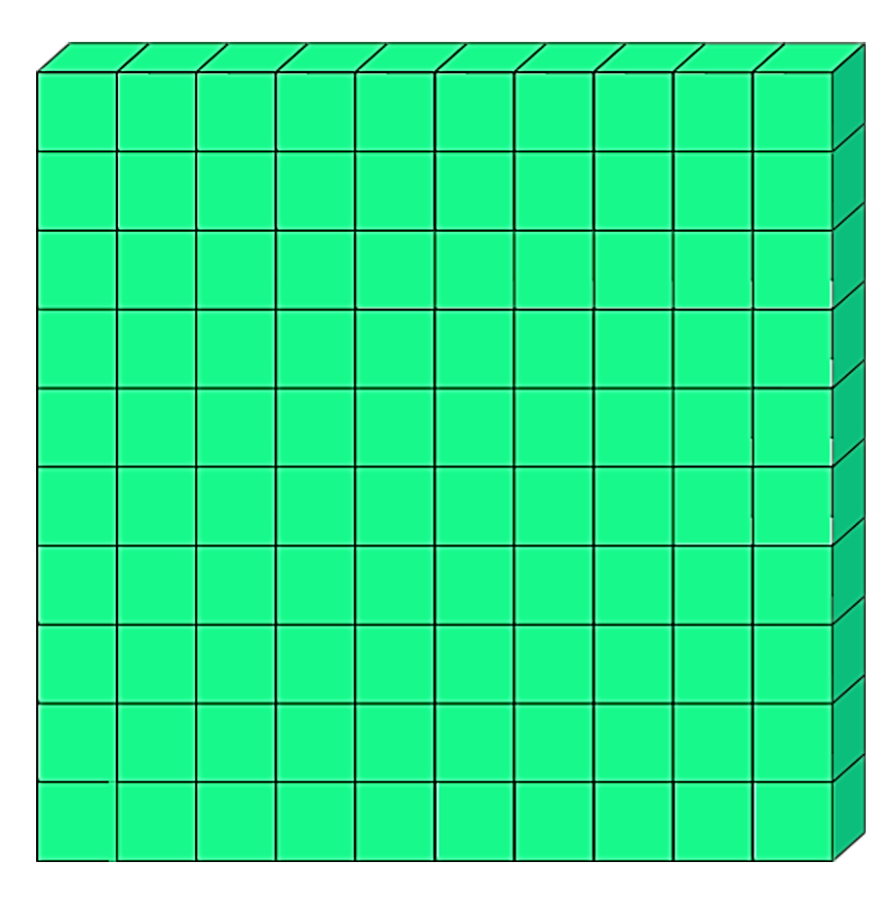
100
10
____ is ten times the size of __
100
____ is ten times greater than __
10

Slide 4
Which number is bigger?
.
Th
H
T
O
t
h
.
1
5
.
1
5
0
.
1
5
0
0
They are all the same. Can you explain why?

Slide 5

When we multiply by 10, every digit moves one place to the left.
The place value chart shows the number 72
So we now have 720
72 x 10 = 720
.
Th
H
T
O
t
.
7
2
0

Slide 6
The place value chart shows the number 43
When we multiply by 100, every digit moves two place to the left.
So we now have 4300
43 x 100 = 4300
.
Th
H
T
O
t
h
.
4
3
4
0
3
0
0
0

Slide 7


Your Turn
1) 28 x 10 =
280
5) 520 x 10 =
5200
2) 17 x 100 =
1700
6) 99 x 100 =
9900
3) 49 x 10 =
490
7) 620 x 10 =
6200
4) 217 x 10 =
2170
8) 101 x 10 =
1010

Slide 8
True or False
33 x 100 = 33 x 10 x 10
True

