Slide 1
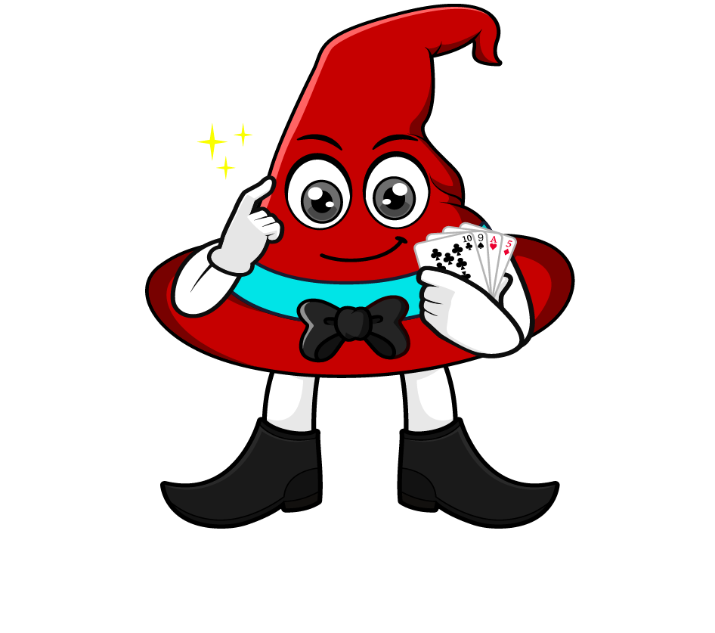

Lesson 1:
Associative law of multiplication
www.arithmagicians.com

Slide 2


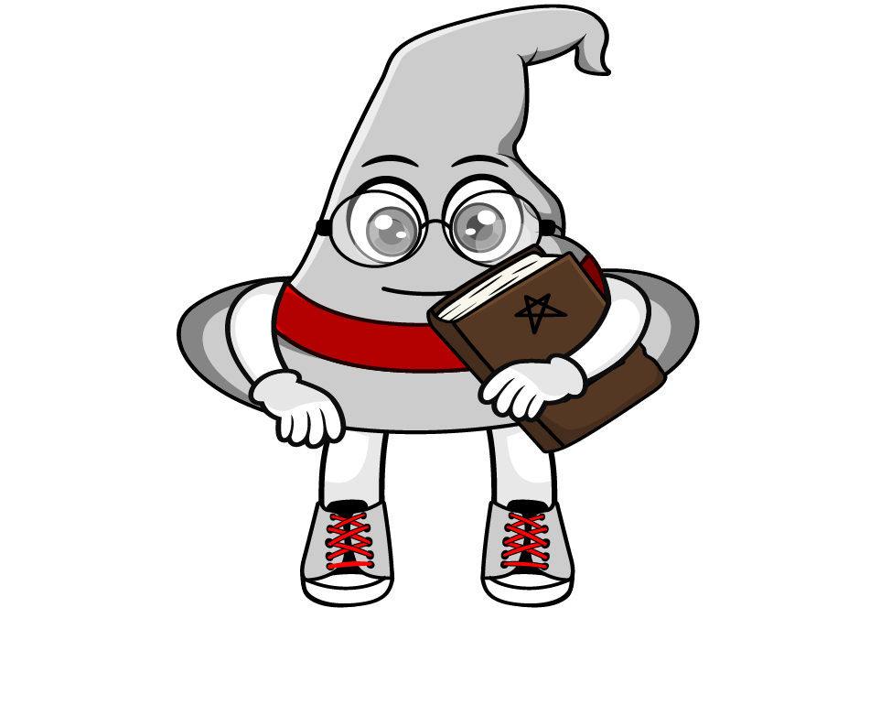
How would you solve
2 x 5 x 4
= (2 × 5) × 4
= 10 × 4
= 40
= 2 × (5 × 4)
= 2 × 20
= 40
They both got 40, but they grouped the numbers differently.
How is this possible?

Slide 3

The associative law of multiplication means:
We can change how numbers are grouped, and the answer stays the same.
=
(2 x 4) x 3 = 2 x (4 x 3)
8 x 3 = 2 x 12
24 = 24

Slide 4

How would you solve
5 x 8 x 2
= (5 × 8) × 2
= 40 × 2
= 80
= 5 × (8 × 2)
= 5 × 16
= 80
= (5 × 2) × 8
= 10 × 8
= 80
Which method do you prefer? Why?

Slide 5


Your Turn
1) 9 x 10 x 3 =
270
2) 13 x 2 x 5 =
130
3) 8 x 10 x 6 =
480
4) 16 x 5 x 2 =
160
5) 10 x 12 x 4 =
480

Slide 6
True or False
(8 × 4) × 5 = 8 × (4 × 5)
True

