Slide 1


Lesson 2:
Skip count in 3s
(Focus 4x3)
www.arithmagicians.com

Slide 2

+3
+3
+3
+3
+3
+3
+3
+3
+3
+3
0
3
6
9
12
15
18
21
24
27
30
Get ready to count up in 3s

Slide 3

0
?
12
15
18
21
24
27
30
3
6
9
What is the missing number?

Slide 4

0
?
?
3
6
9
12
15
18
21
24
27
30
What are the missing numbers?

Slide 5
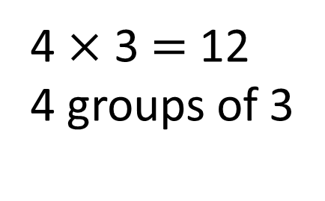
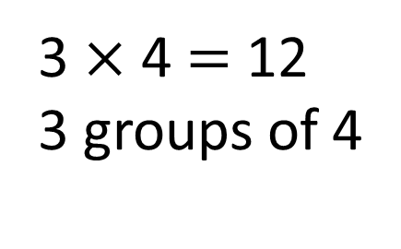
3
3
3
3
4 $×$ 3 $=$ 12
4 groups of 3
0
3
6
9
12
4
4
4
3 $×$ 4 $=$ 12
3 groups of 4
0
4
8
12

Slide 6
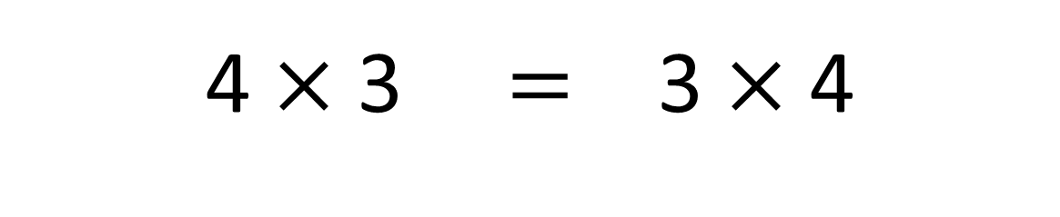
True
True or False
4 $×$ 3 $=$ 3 $×$ 4

Slide 7


Solve: 4 x 3
Amy:
I am going to skip count in 4s, three times.
+4
+4
+4
0
4
8
12
+3
+3
+3
+3
Ben:
I am going to skip count in 3s, four times.
0
3
6
9
12
Which method is quicker – why?

Slide 8



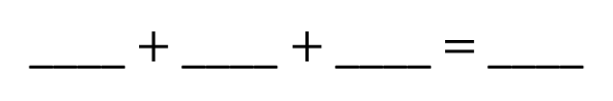
Your Turn
Addition Sentence
Complete Bar Model
4
4
4
12
12
____ $+$ ____ $+$ ____ $=$ ____
3 | 3 | 3 | 3
4 x 3 = 12
3 x 4 = 12
Draw this question: There are 3 plates of cookies. There are 4 cookies on each plate. What times table does this represent?
3 x 4

Slide 9

True or False:
Ben has more cookies because
he has more plates?
False: Why?

