Slide 1


Lesson 2: Add 10
www.arithmagicians.com

Slide 2

+10
+10
+10
+10
+10
+10
+10
+10
+10
10
20
30
40
50
60
70
80
90
100
Get ready to count up in 10s

Slide 3

?
10
20
30
40
50
60
70
80
90
100
What is the missing number?

Slide 4
?
10
20
30
40
50
60
70
80
90
100
What is the missing number?

Slide 5
?
?
70
10
20
30
40
50
60
80
90
100
What are the missing numbers?

Slide 6
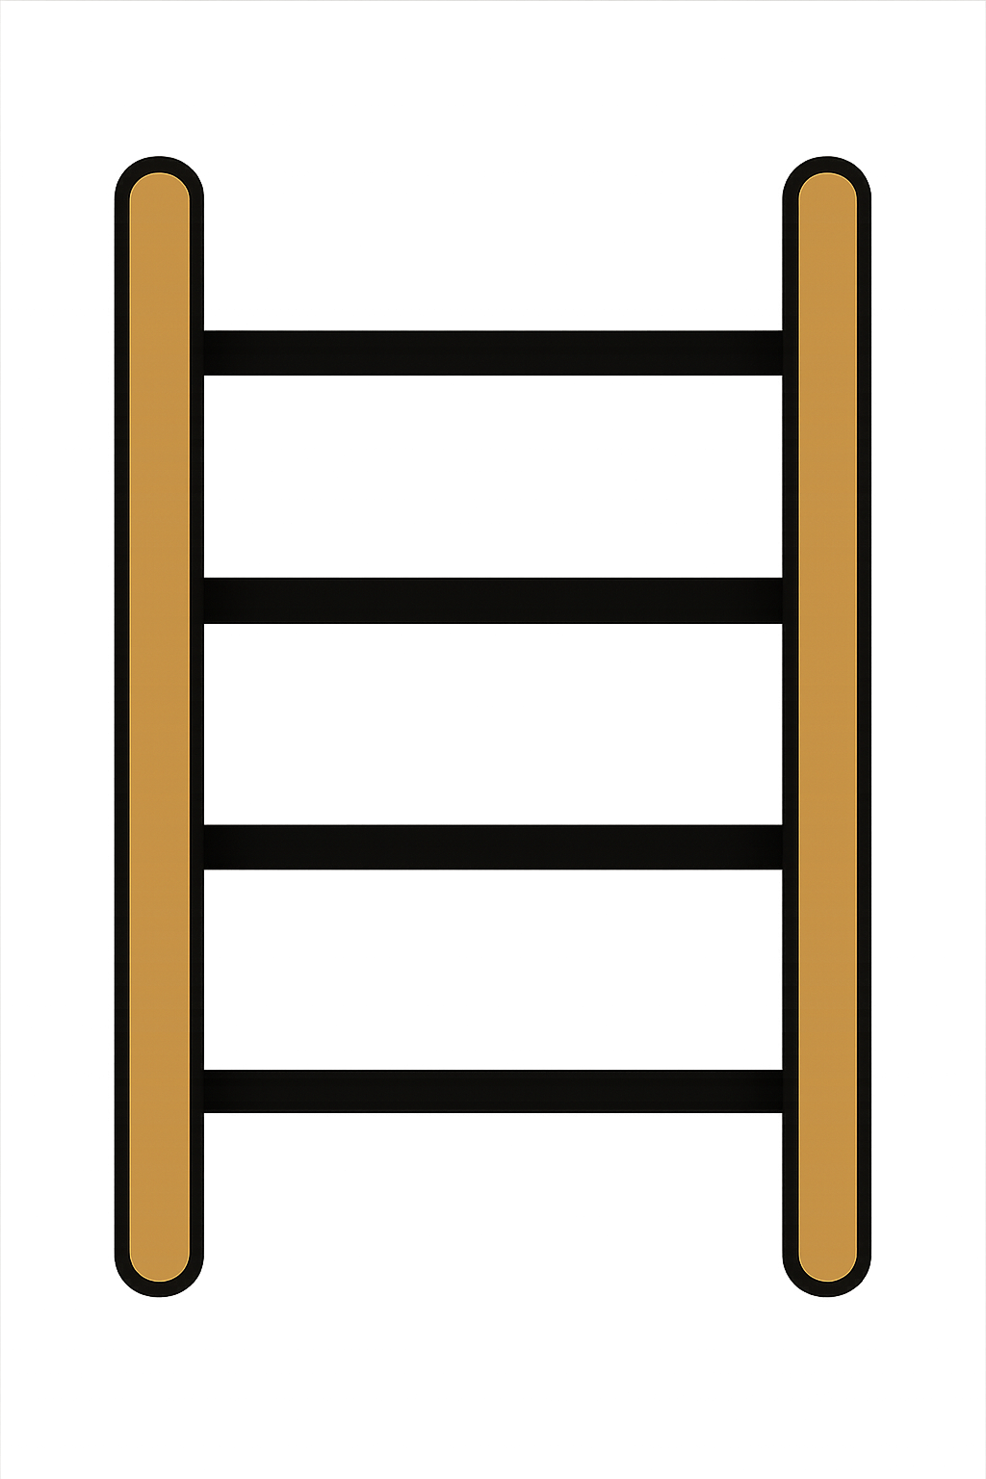
20 + 10 =
30

Slide 7
30 + 10 =
40

Slide 8
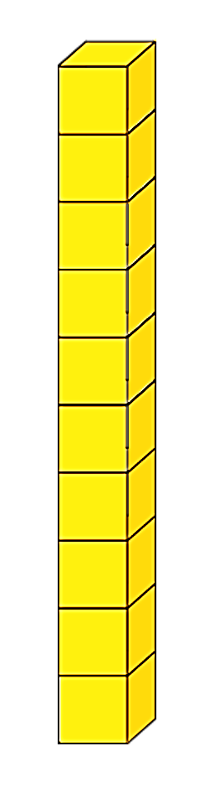
50 + 10 =
60
+
=

Slide 9
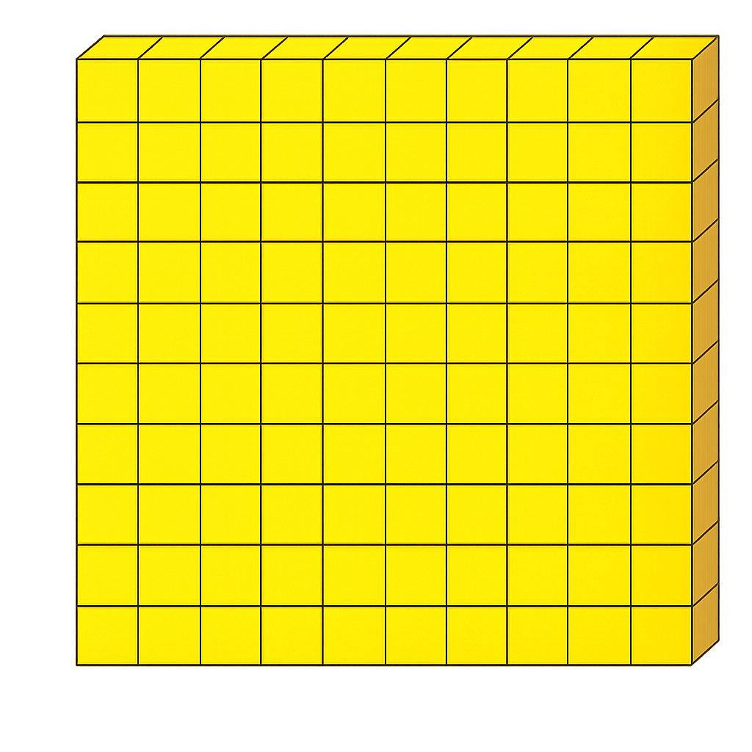
100
90 + 10
+

Slide 10


Your Turn
80
70 + 10 = ?
50
2) 40 + 10 = ?
3) 50 + 10 = ?
60
4) 80 + 10 = ?
90
5) ? + 10 = 70
60

Slide 11

True or False
When you add 10, the ones digit stays the same.
True

