Slide 1
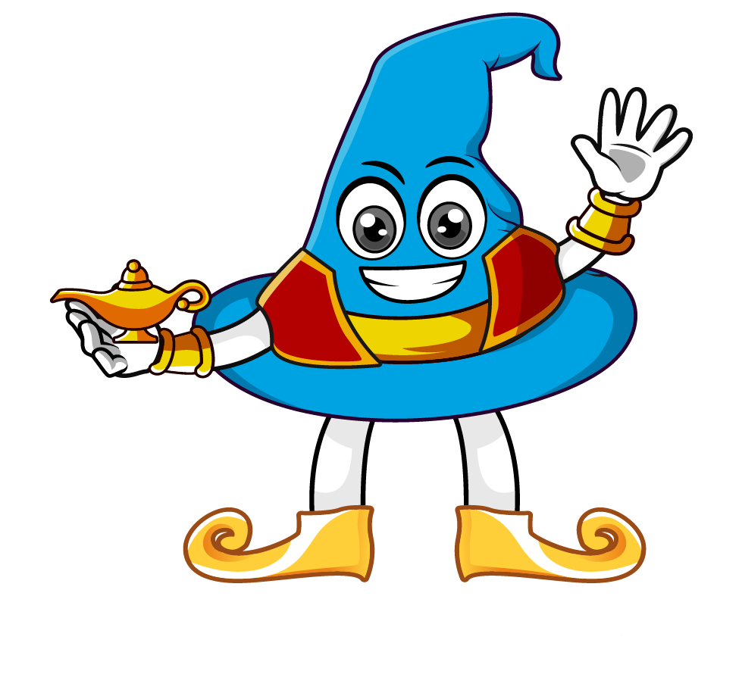

Lesson 2:
Multiply by 10, 100 & 1000
www.arithmagicians.com

Slide 2

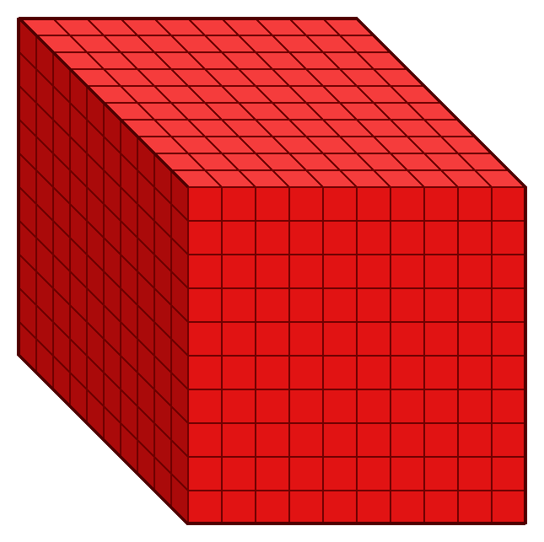
4
4 thousands
__ × 1 thousand =
1000
4,000
4 × ______ =
4
4,000
1,000 × __ =

Slide 3
Which number is bigger?
45
45.0
45.00
45.000
They are all the same. Can you explain why?

Slide 4

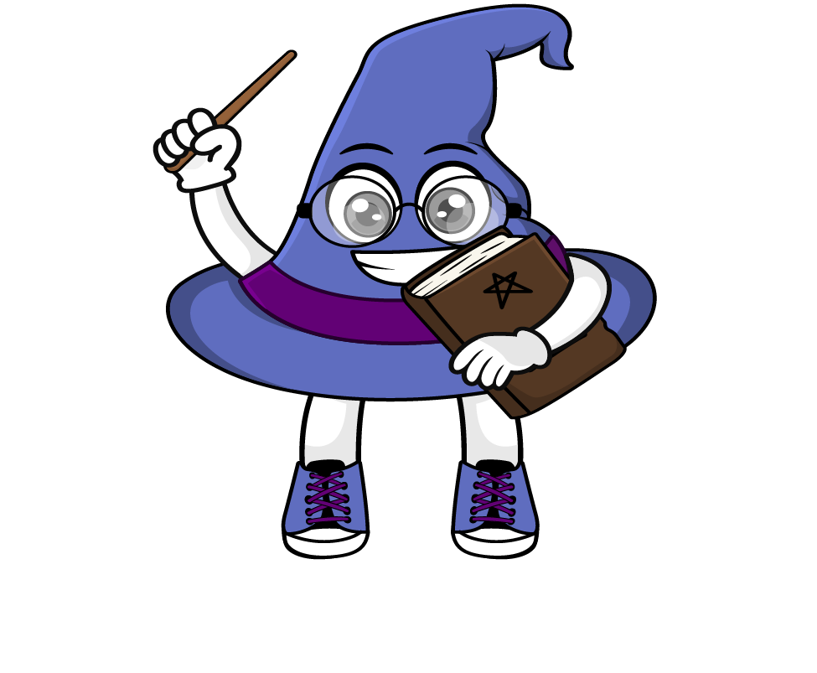
The place value chart shows the number 62
When we multiply by 1000, every digit moves three place to the left.
So we now have 62000
62 x 1000 = 62000
.
HTh
Th
H
T
O
t
h
th
.
6
2
6
0
2
6
0
0
2
0
0
0
0
0
0

Slide 5
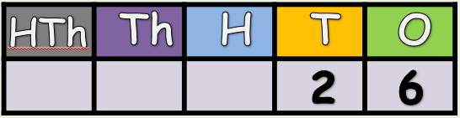

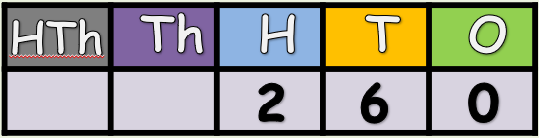
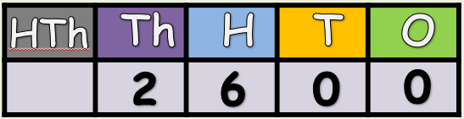
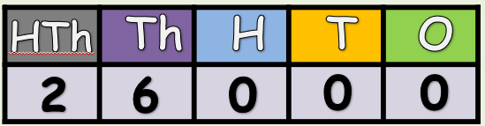
x10
What do
you notice?
x10
x10

Slide 6


Your Turn
36
52,000
1) 36 x 1 =
5) 52 x 1000 =
2) 36 x 10 =
360
6) 1000 x 9 =
9000
3600
7) 99 x 1000 =
99,000
3) 36 x 100 =
4) 36 x 1000 =
36,000
8)101 x 1000=
101,000

Slide 7
True or False
45 x 1000 = 45 x 100 x 10
True: Can you explain why?

