Slide 1


Lesson 2:
Associative law of multiplication
www.arithmagicians.com

Slide 2

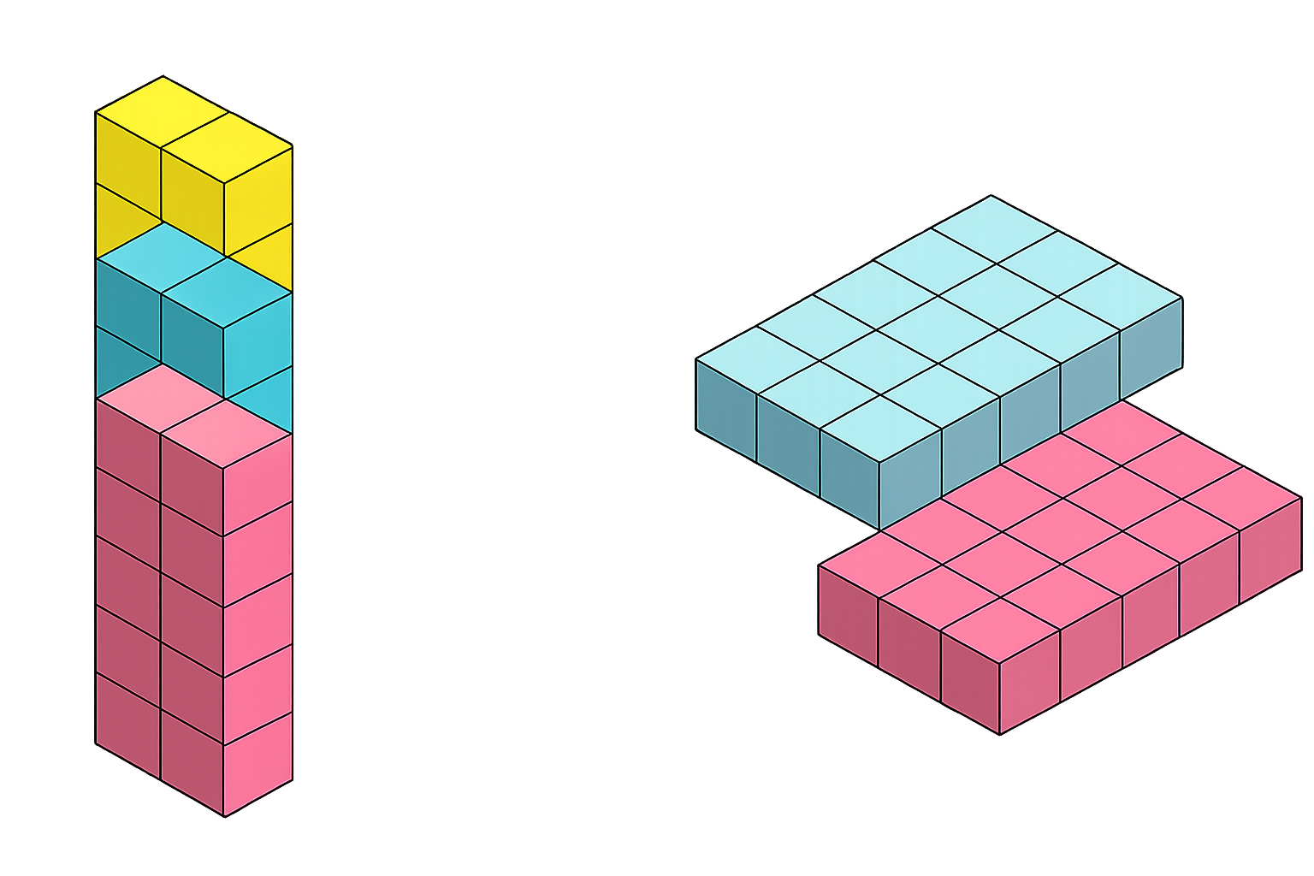
The associative law of multiplication means:
We can change how numbers are grouped, and the answer stays the same.
=
(2 x 5) x 3 = 2 x (5 x 3)
10 x 3 = 2 x 15
30 = 30

Slide 3


How would you solve
24 x 5 x 2
= (24 × 5) × 2
= 120 × 2
= 240
= 24 × (5 × 2)
= 24 × 10
= 240
Which method do you prefer?
Why?

Slide 4


Your Turn
1) 9 x 4 x 25 =
900
2) 20 x 18 x 5 =
1800
3) 4 x 50 x 6 =
1200
4) 37 x 5 x 2 =
370
5) 8 x 10 x 7 =
560

Slide 5
True or False
Using the associative law can make calculations easier but does not change the answer.
True

