Slide 1


Lesson 3:
Skip count in 3s
(Focus 5x3)
www.arithmagicians.com

Slide 2

+3
+3
+3
+3
+3
+3
+3
+3
+3
+3
0
3
6
9
12
15
18
21
24
27
30
Get ready to count up in 3s

Slide 3

0
3
6
?
?
21
24
27
30
9
12
15
18
What are the missing numbers?

Slide 4



5
There are ____ groups.
5
3
There are ____ equal groups of ____
There are ____ in each group.
3
____ $+$____ $+$____ $+$ ____ $+$ ____ $=$ ____
3
3
3
3
3
15
There are ____ altogether.
15
5
15
5
3
15
3
____ $×$ ____ $=$ ____
____ $×$ ____ $=$ ____

Slide 5
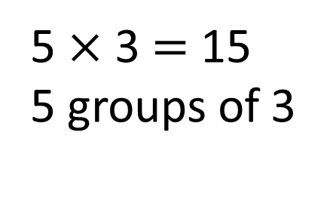
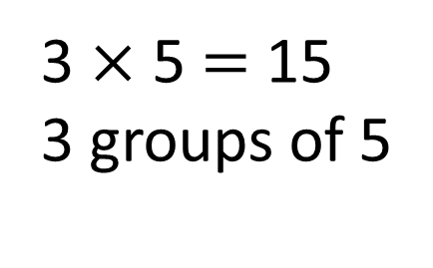
3
3
3
3
3
5 $×$ 3 $=$ 15
5 groups of 3
0
3
6
9
12
15
5
5
5
3 $×$ 5 $=$ 15
3 groups of 5
0
5
10
15

Slide 6


True
True or False
5 $×$ 3 $=$ 3 $×$ 5

Slide 7


Solve: 5 x 3
Jasmin:
I am going to skip count in 3s, five times.
+3
+3
+3
+3
+3
0
3
6
9
12
15
Ali:
I am going to skip count in 5s, three times
+5
+5
+5
0
5
10
15
Which method is quicker – why?

Slide 8



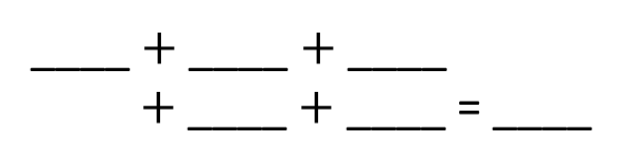

Your Turn
Write an addition sentence for 3 x 5
Write an addition sentence for 5 x 3
3
3
3
5
5
5
15
____ $+$ ____ $+$ ____
$+$ ____ $+$ ____ = ____
____ $+$ ____ $+$ ____ $=$ ____
3
3
15
5 x 3 = 15
3 x 5 = 15
Draw this question: There are 3 pots of pencils. There are 5 pencils in each pot. What times table does this represent?
3 x 5

Slide 9
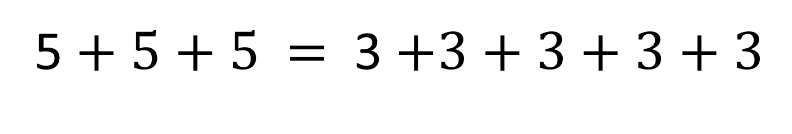
True or False:
5 $+ 5+5$ $=$ 3 $+3+3+3+3$
True

