Slide 1
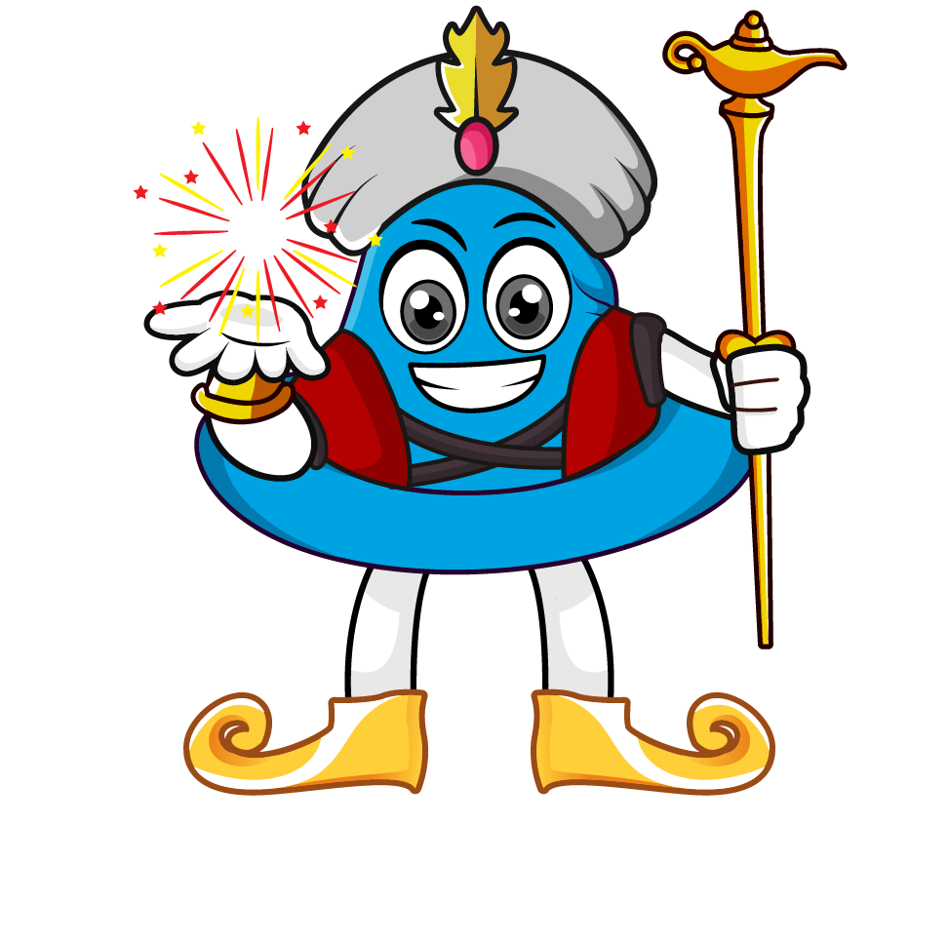
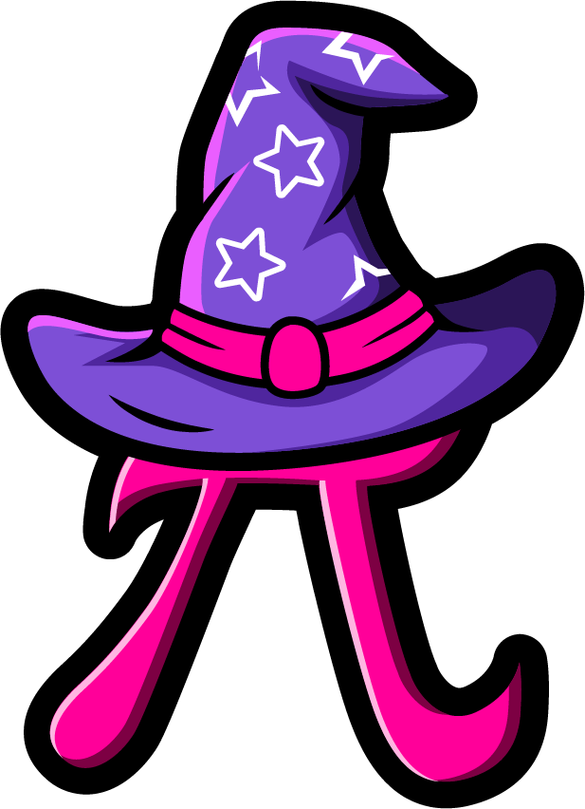
Lesson 3:
Multiply by 1000
www.arithmagicians.com

Slide 2

Let’s recap what we have learnt so far?
1) To multiply a number by 10 each digit moves
to the left on a place value grid.
1
2) To multiply a number by 100 each digit moves
to the left on a place value grid.
2
3) To multiply a number by 1,000 each digit moves
to the left on a place value grid.
3

Slide 3

____ multiplied by 1,000 is equal to _______
499
8
33
6
33,000
6,000
8,000
499,000

Slide 4

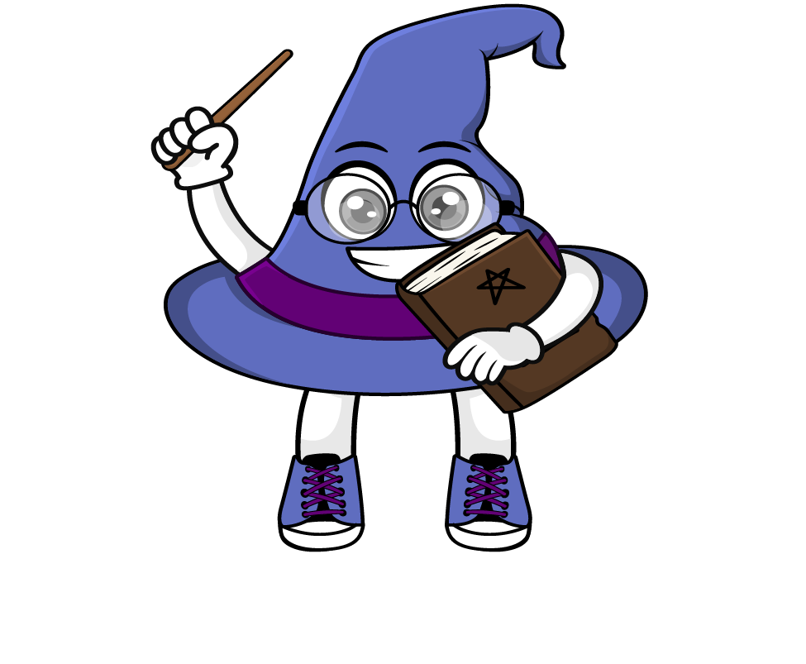
The place value chart shows the number 38
When we multiply by 1000, every digit moves three place to the left.
So we now have 38000
38 x 1000 = 38000
.
HTh
Th
H
T
O
t
h
th
.
3
8
0
0
0
3
8
3
0
8
0
0
0
0
0

Slide 5


Your Turn
99
5) 47 x 1000 =
47,000
1) 99 x 1 =
2) 99 x 10 =
990
6) 1000 x 7 =
7000
9,900
7) 54 x 1000 =
54,000
3) 99 x 100 =
4) 99 x 1000=
99,000
8)544 x1000=
544,000

Slide 6
True or False
23 x 1000 = 23 x 100 x 100
False: Can you explain why?

