Slide 1
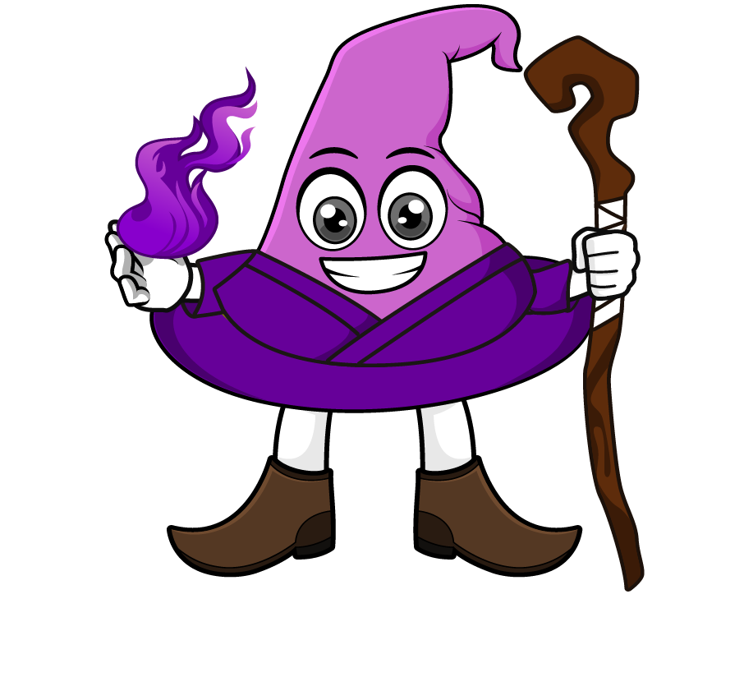
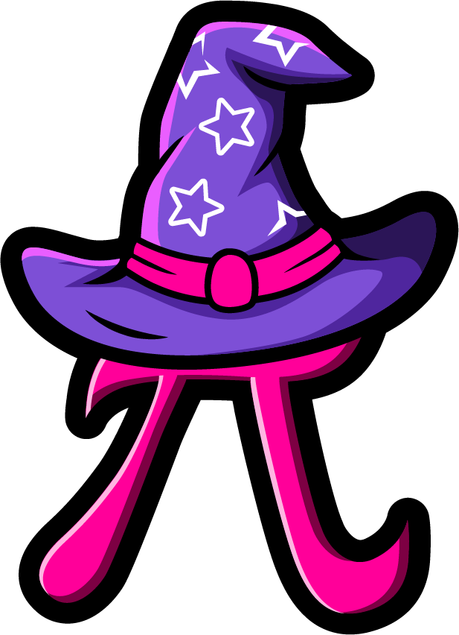
Lesson 3:
Associative law of multiplication
www.arithmagicians.com

Slide 2

The associative law of multiplication means:
We can change how numbers are grouped, and the answer stays the same.
=
(3 x 2) x 2
=
3 x (2 x 2)
6 x 2
=
3 x 4
=
12
12

Slide 3

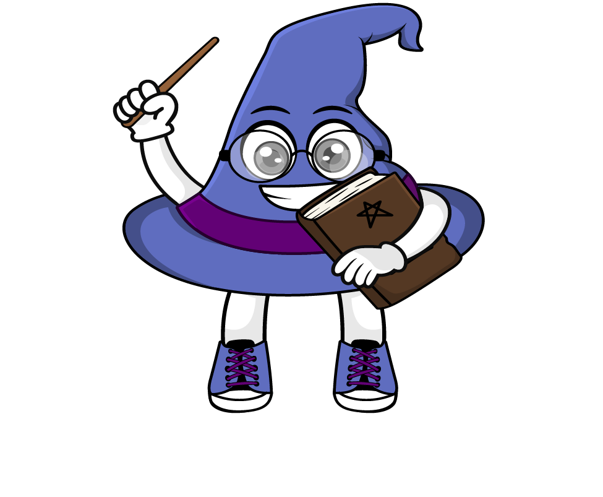
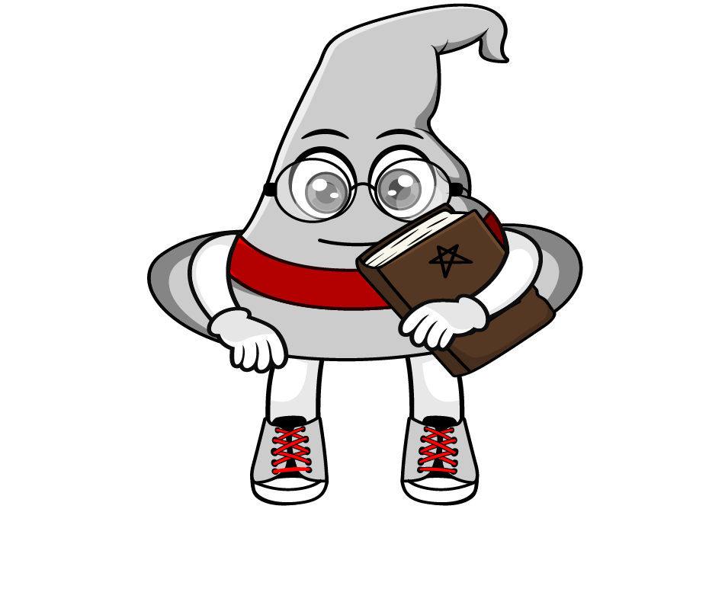
How would you solve
16 x 50 x 2
= (16 × 50) × 2
= 800 × 2
= 1600
= 16 × (50 × 2)
= 16 × 100
= 1600
Which method do you prefer?
Why?

Slide 4


Your Turn
1) 28 x 4 x 25 =
2800
2) 20 x 36 x 5 =
3600
3) 17 x 50 x 2 =
1700
4) 2 x 54 x 5 =
540
5) 6 x 10 x 8 =
480

Slide 5
True or False
(a x b) x c = a x (b x c)
True

