Slide 1
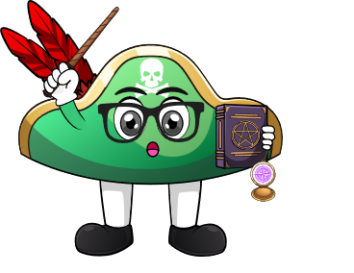
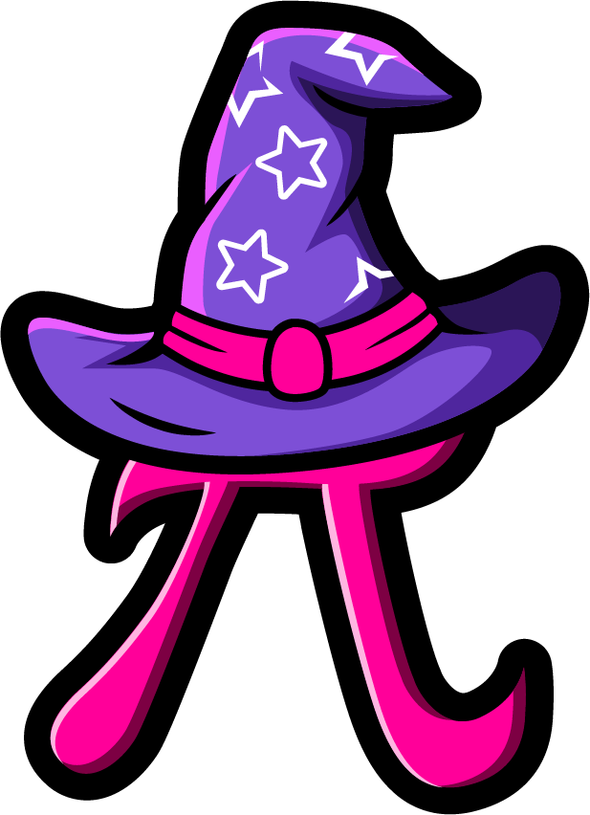
Lesson 4:
Add 1 to a number
www.arithmagicians.com

Slide 2



+
=
+
4
+
1
=
1
+
4
What is the same and what is different?

Slide 3


Solve: 1 + 6
Ben:
“I am going to start on 1 and count on 6 times.”
1
2
3
4
5
6
7
Amy:
“I am going to start on 6 and count on 1 time.”
6
7
Which is quicker?

Slide 4

1
+
8
=
9
Swap the numbers

Slide 5


Your Turn
8
1 + 7 = ?
6
2) 1 + 5 = ?
Remember
to swap
the
numbers
4
3) 1 + 3 = ?
10
4) 1 + 9 = ?
7
5) 1 + 6 = ?

Slide 6
True or False
3 + 1 is not the same as 1 + 3
False

