Slide 1
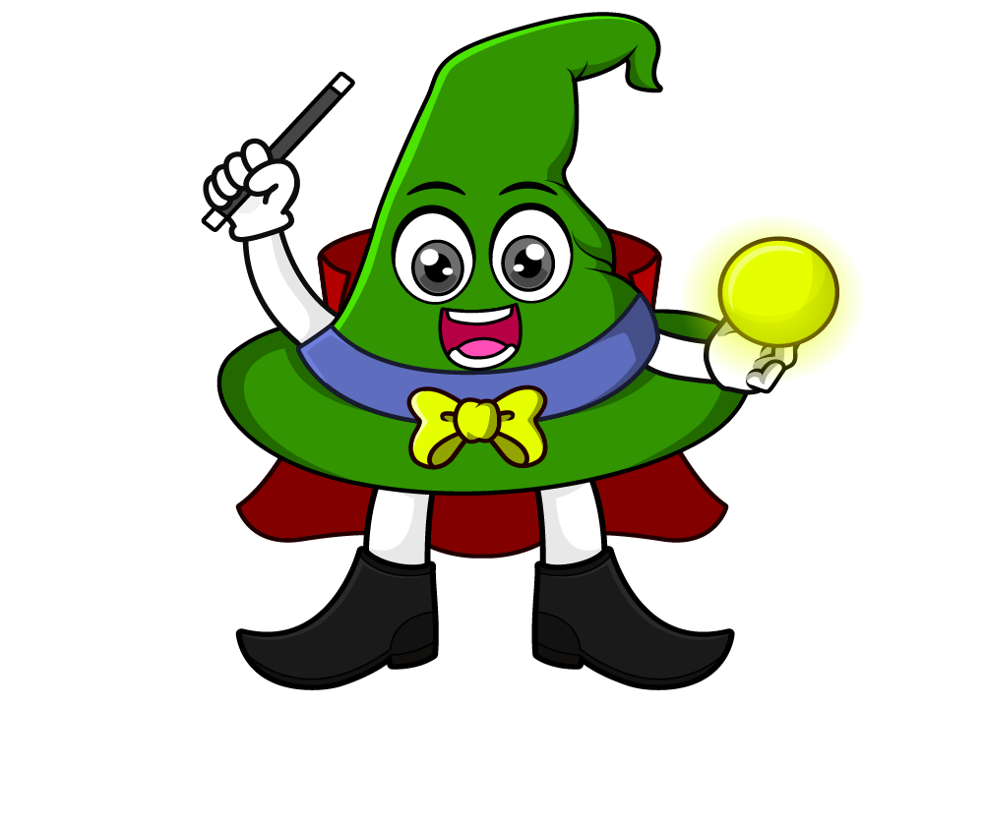

Lesson 4:
Multiply by 1000
www.arithmagicians.com

Slide 2

Let’s recap what we have learnt so far?
1) To multiply a number by 10 each digit moves
to the left on a place value grid.
1
2) To multiply a number by 100 each digit moves
to the left on a place value grid.
2
3) To multiply a number by 1,000 each digit moves
to the left on a place value grid.
3

Slide 3

____ multiplied by 1,000 is equal to _______
725
9
22
725,000
22,000
9,000

Slide 4


Your Turn
A small town library has 35 books.
A city library has 1000 times as many books.
How many books does the city library have?
35 × 1000 = 35,000 books
2) A snail moved 6 metres. A cyclist travelled 6,000 metres.
How many times further did the cyclist travel?
6 × 1,000 = 6,000 → 1,000 times further

Slide 5
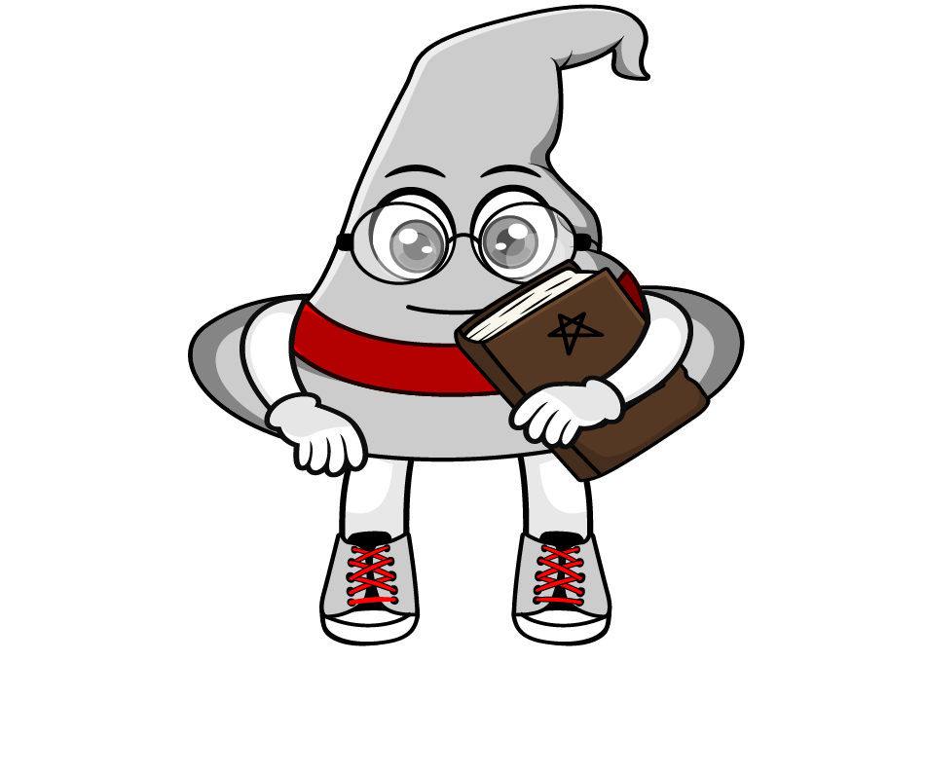
True or False
45 x 1000 = 4500
False: What mistake did Rookie make?

