Slide 1
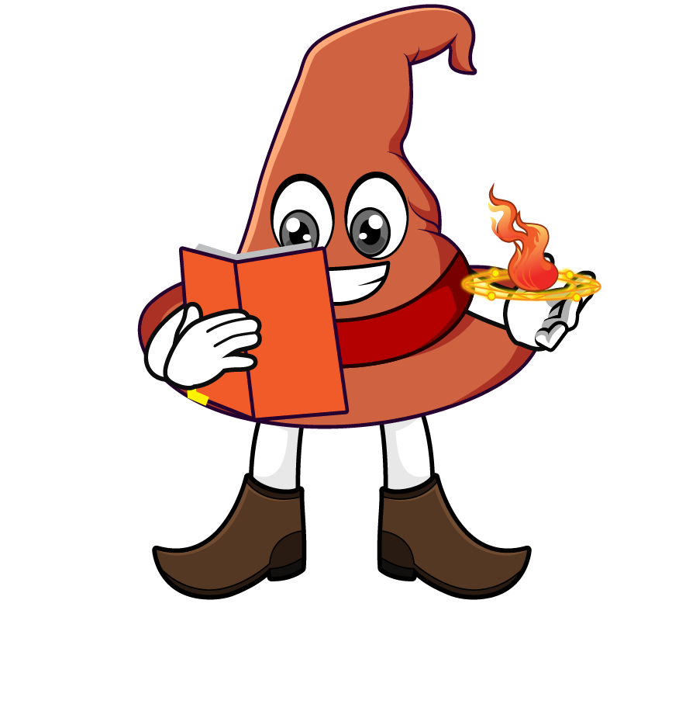

Lesson 4:
Associative law of multiplication
www.arithmagicians.com

Slide 2

The associative law of multiplication means:
we can ________ how numbers are _________ , and the answer stays the ________.
change
grouped
same

Slide 3

Associative Law
=
(2 x 4) x 3 = 2 x (4 x 3)
8 x 3 = 2 x 12
24 = 24

Slide 4

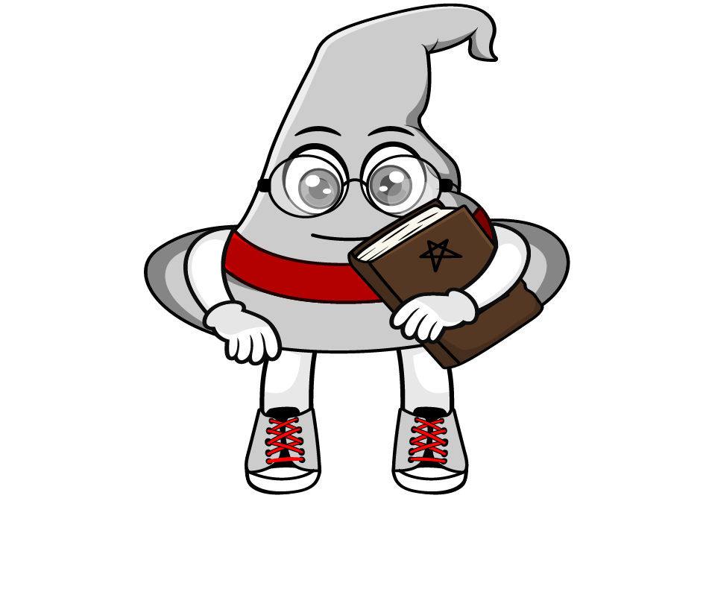
How would you solve
39 x 20 x 5
= (39 × 20) × 5
= 780 × 5
= 3900
= 39 × (20 × 5)
= 39 × 100
= 3900
Which method do you prefer?
Why?

Slide 5


Your Turn
1) 4 x 10 x 6 =
240
2) 46 x 50 x 2 =
4600
3) 20 x 97 x 5 =
9700
4) 2 x 82 x 5 =
820
5) 47 x 4 x 25 =
4700

Slide 6
True or False
Changing how numbers are grouped in a multiplication changes the answer.
False

