Slide 1


Lesson 5:
Assess and Review
www.arithmagicians.com

Slide 2

+3
+3
+3
+3
+3
+3
+3
+3
+3
+3
0
3
6
9
12
15
18
21
24
27
30
Get ready to count up in 3s

Slide 3
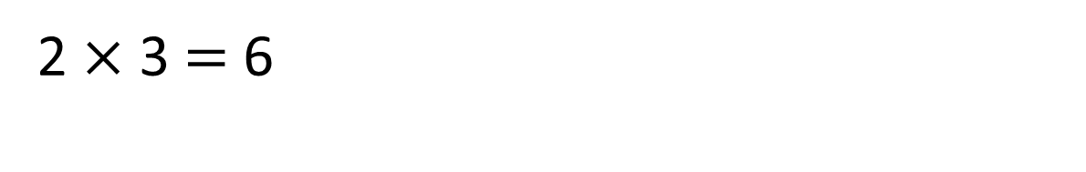
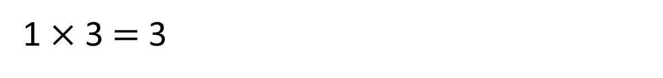
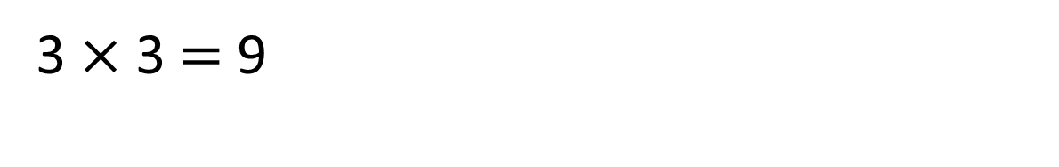
3
1 $×$ 3 $=$ 3
0
3
3
3
2 $×$ 3 $=$ 6
0
3
6
3
3
3
3 $×$ 3 $=$ 9
0
3
6
9

Slide 4

Which way is quicker when using skip counting? Why?
3
3
3
3
4 $×$ 3 $=$ 12
4 groups of 3
0
3
6
9
12
4
4
4
3 $×$ 4 $=$ 12
3 groups of 4
0
4
8
12

Slide 5
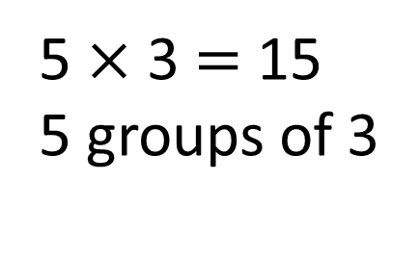
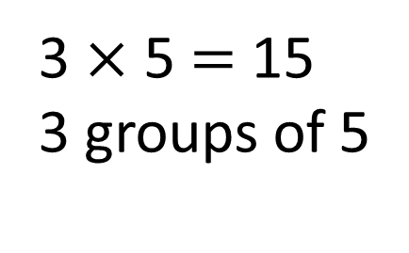
Which way is quicker when using skip counting? Why?
3
3
3
3
3
5 $×$ 3 $=$ 15
5 groups of 3
0
3
6
9
12
15
5
5
5
3 $×$ 5 $=$ 15
3 groups of 5
0
5
10
15

Slide 6


Your Turn
1) 2 x 3 =
6
6) 4 x 3 =
12
2) 3 x 1 =
3
7) 3 x 2 =
6
3) 5 x 3 =
15
8) 0 x 3 =
0
4) 3 x 4 =
12
9) 3 x 3 =
9
5) 3 x 5 =
15
10) 3 x 0 =
0

