Slide 1


Lesson 5:
Assess and Review
www.arithmagicians.com

Slide 2

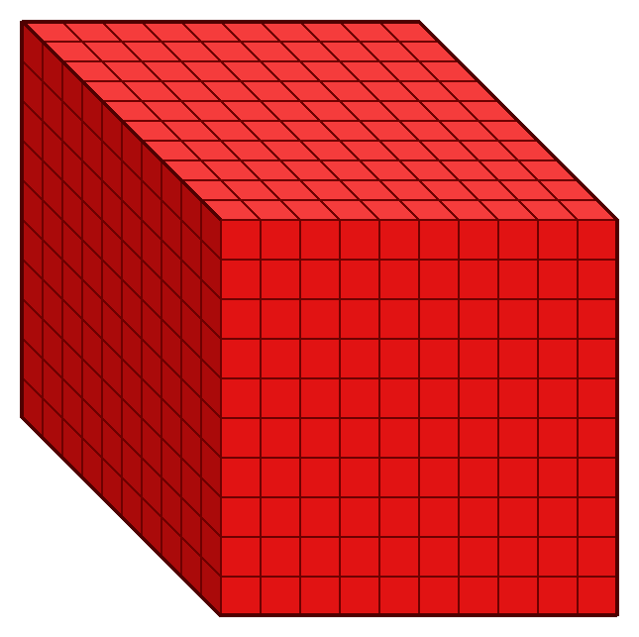
5
5 thousands
__ × 1 thousand =
1000
5,000
5 × ______ =
5
5,000
1,000 × __ =

Slide 3


When we multiply by 1000, every digit moves three place to the left.
The place value chart shows the number 99
So we now have 99,000
99 x 1000 = 99,000
.
HTh
Th
H
T
O
t
h
th
.
9
9
9
9
0
9
9
0
0
0
0
0
0
0
0

Slide 4

____ multiplied by 1,000 is equal to _______
656
2
44
656,000
44,000
2,000

Slide 5


Your Turn
44
72,000
1) 44 x 1 =
5) 72 x 1000 =
2) 44 x 10 =
440
6) 1000 x 7 =
7000
4,400
7) 77 x 1000 =
77,000
3) 44 x 100 =
4) 44 x 1000 =
44,000
8) 111 x1000=
111,000

