Slide 1


Lesson 5:
Assess and Review
www.arithmagicians.com

Slide 2

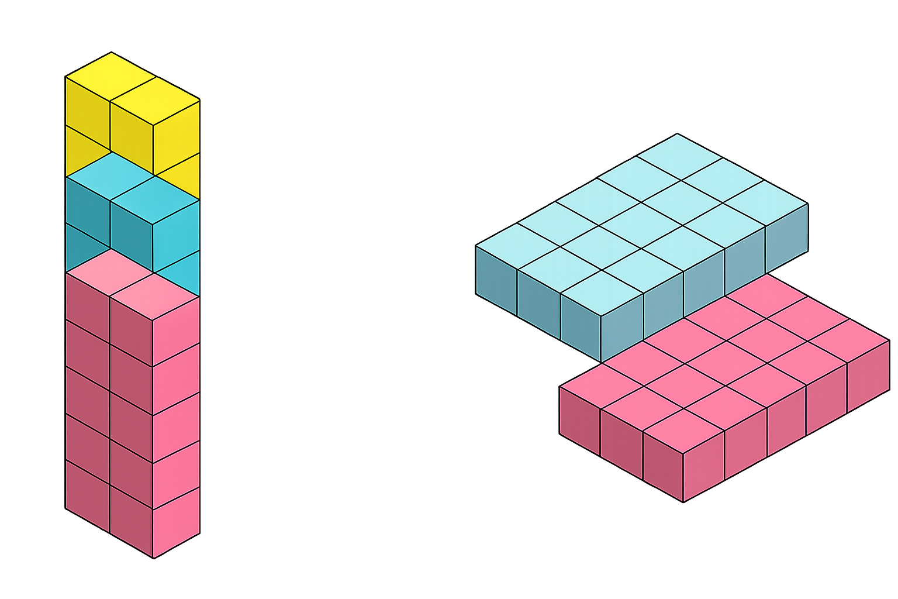
The associative law of multiplication means: We can change how numbers are grouped, and the answer stays the same.
=
(2 x 5) x 3 = 2 x (5 x 3)
10 x 3 = 2 x 15
30 = 30

Slide 3


Your Turn
1900
5) 7 x 10 x 6 =
420
1) 20 x 19 x 5 =
1200
6) 39 x 5 x 2 =
390
2) 4 x 50 x 6 =
8700
7) 8 x 4 x 25 =
800
3) 20 x 87 x 5 =
4200
770
4) 42 x 50 x 2 =
8) 2 x 77 x 5 =

