Slide 1


Lesson 1:
6 x 3 table
(Using skip counting)
www.arithmagicians.com

Slide 2

+3
+3
+3
+3
+3
+3
+3
+3
+3
+3
0
3
6
9
12
15
18
21
24
27
30
Get ready to count up in 3s

Slide 3


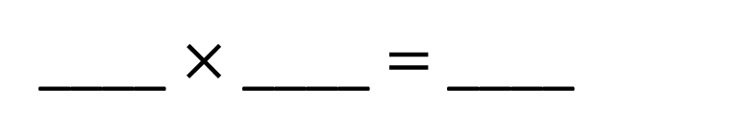
6
There are ____ groups.
3
There are ____ in each group.
18
There are ____ altogether.
18
____ $×$ ____ $=$ ____
6
3

Slide 4
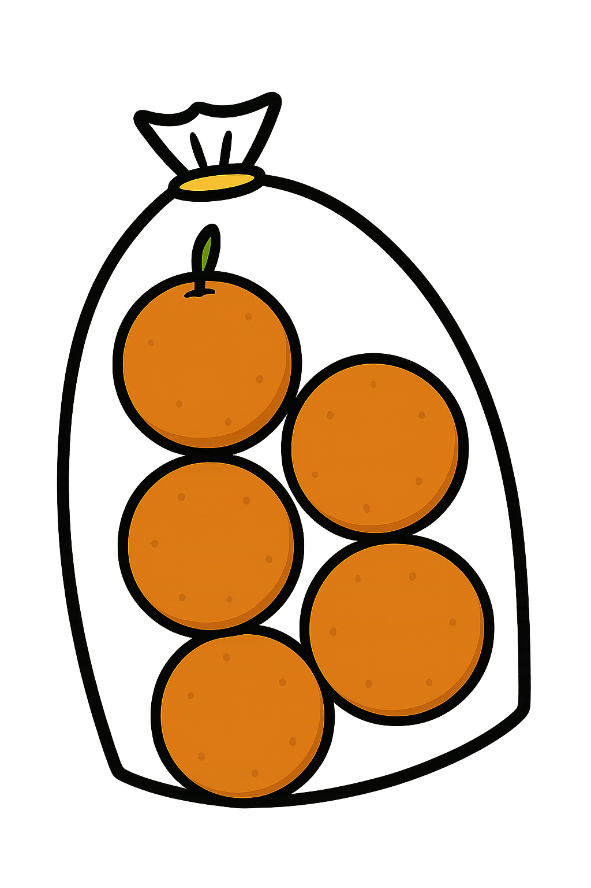
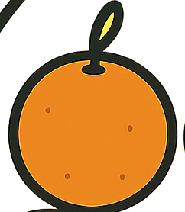
3
There are ____ groups.
6
There are ____ in each group.
18
There are ____ altogether.
18
____ $×$ ____ $=$ ____
3
6

Slide 5


True
True or False
6 $×$ 3 $=$ 3 $×$ 6

Slide 6


Solve: 6 x 3
Ben:
I am going to skip count in 6s, three times.
+6
+6
+6
0
6
12
18
Amy:
I am going to skip count in 3s, six times.
+3
+3
+3
+3
+3
+3
0
3
6
9
12
15
18
Which method is quicker – why?

Slide 7


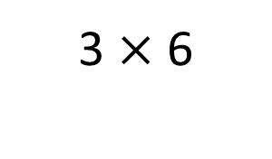
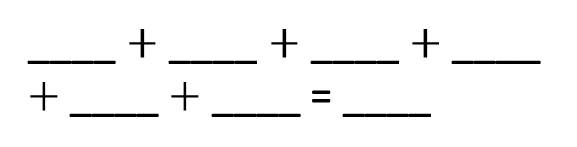
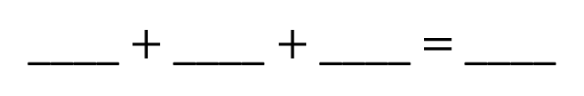
Your Turn
Write an addition sentence for 3 x 6
Write an addition sentence for 6 x 3
3
3
3
3
6
6
6
18
____ $+$ ____ $+$ ____ $+$ ____ $+$ ____ $+$ ____ = ____
____ $+$ ____ $+$ ____ $=$ ____
3
3
18
6 x 3 = 18
3 x 6 = 18
Draw this question:
There are 3 bags of oranges.
There are 6 oranges in each bag.
What times table does this represent?
3 $×$ 6

Slide 8

True or False
6 x 3 = 9
False:
what mistake did Novice make?

