Slide 1


Lesson 2:
6 x 3 table
(using: double + one more group strategy)
www.arithmagicians.com

Slide 2

+3
+3
+3
+3
+3
+3
+3
+3
+3
+3
0
3
6
9
12
15
18
21
24
27
30
Get ready to count up in 3s

Slide 3


True
Recap: True or False
6 $×$ 3 $=$ 3 $×$ 6

Slide 4

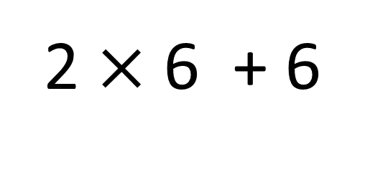
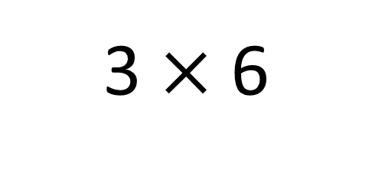
True
True or False
3 $×$ 6
=
2 $×$ 6 + 6
=
3
__ groups of 6 is the same as 2 groups of __ plus __ more
6
6

Slide 5


Solve: 3 x 6
I am going to solve 3 × 6 using the ‘double and one more group’ strategy
Next: I will add 6 more
First: I will double 6
18
12

Slide 6


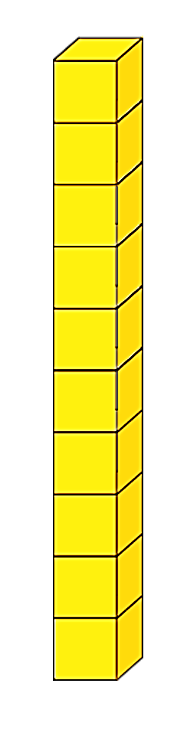
I wan to solve 3 x 6 using the ‘double and one more group’ strategy.
Can you help?
Great! What do I need to do first?
What do I do next?
+
+
+ 6 more
Double 6
= 18

Slide 7


Your Turn
Do you have a different strategy?
Which strategy do you prefer? Why?
Show 3 different ways of solving 3 x 6
Skip count in 6s, three times
Double + one more
group strategy
+6
+6
+6
3 x 6 = 2 x 6 + 6
0
6
12
18
Skip count in 3s, six times
+3
+3
+3
+3
+3
+3
0
3
6
9
12
15
18

