Slide 1


Lesson 2:
Add 10 to any number
www.arithmagicians.com

Slide 2


What do you notice?
+10
+10
+10
+10
+10
+10
+10
+10
+10
3
13
23
33
43
53
63
73
83
93
ten
I notice that when you add ____, the ones digit stays the _____ but the tens digit increases by ____.
Get ready to count up in 10s
same
one

Slide 3
?
3
13
23
33
43
53
63
73
83
93
What is the missing number?

Slide 4
?
3
13
23
33
43
53
63
73
83
93
What is the missing number?

Slide 5
?
?
3
13
23
33
43
53
63
73
83
93
What are the missing numbers?

Slide 6
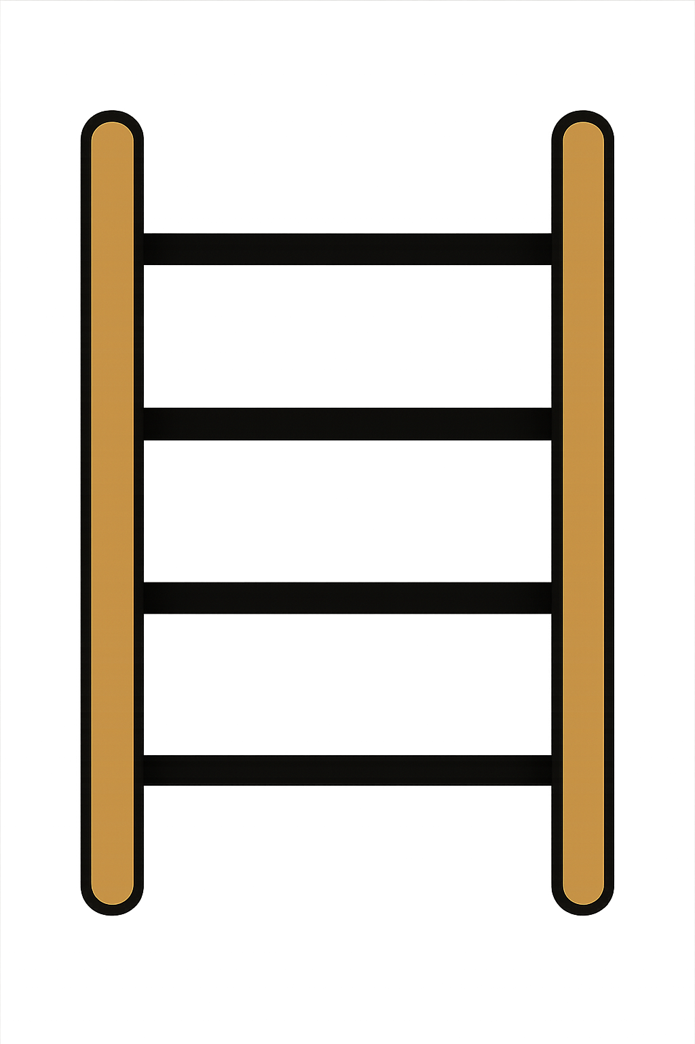
10 + 28 =
38

Slide 7
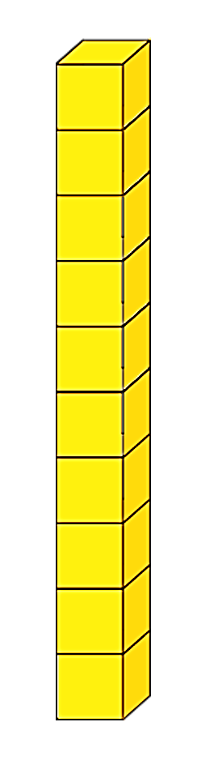

10 + 34
+
44

Slide 8
10 + 42
+
52

Slide 9

What do you notice?
10
+
34
=
44
10
+
42
=
52
What is the same?
What is different?

Slide 10


Your Turn
53
10 + 43 = ?
37
2) 10 + 27 = ?
3) 68 + 10 = ?
78
69
4) 59 + 10 = ?
5) 10 + 77 = ?
87

Slide 11

True or False
24 + 10 = 25
False (It’s 34)
What was Sailor’s mistake?

