Slide 1
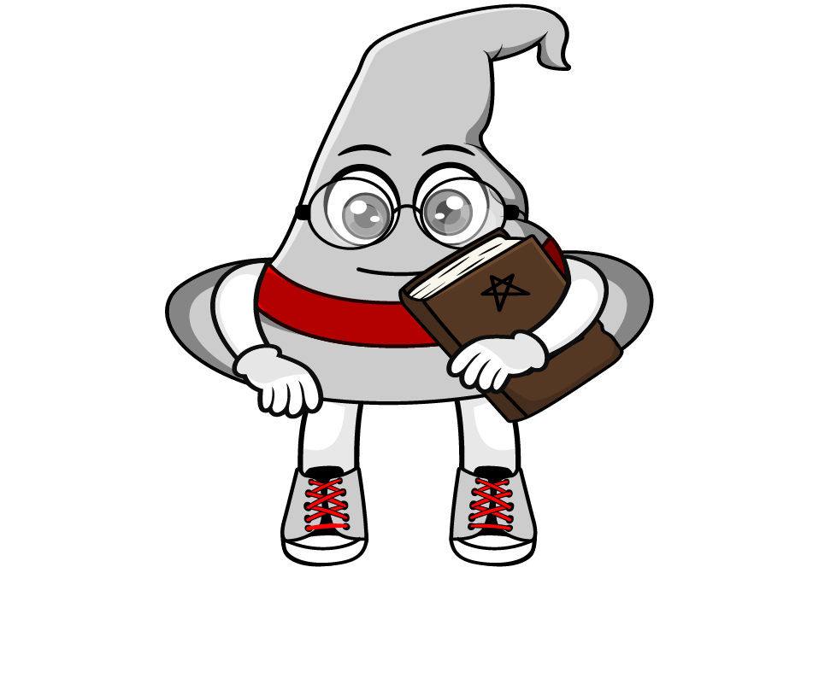
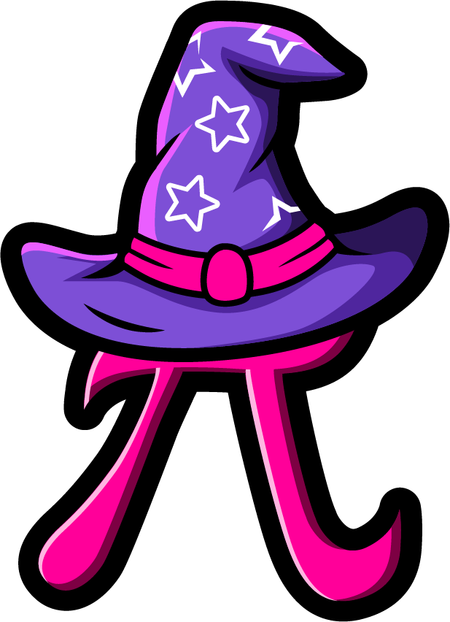
Lesson 2:
Repeated multiplication by 10
(x10 x 10 x 10)
www.arithmagicians.com

Slide 2

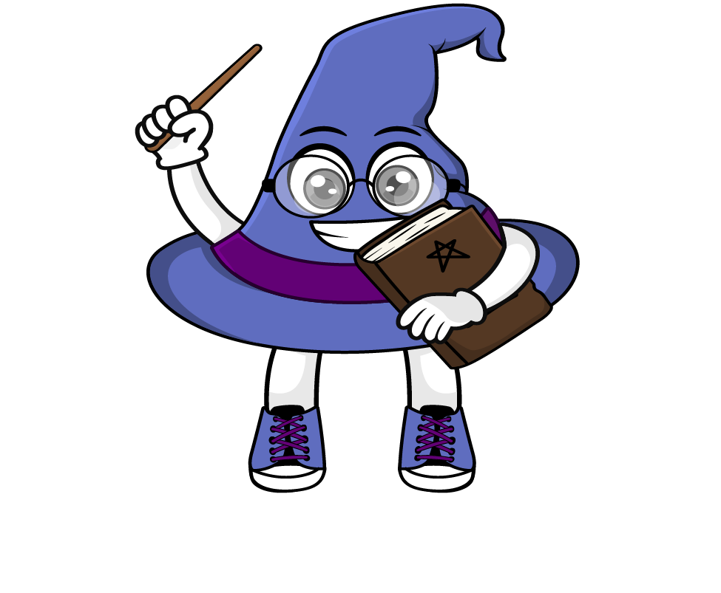
Each time we multiply by 10, the digits move one place to the left.
That’s why multiplying by 1000 is the same as multiplying by 10 three times.
Let’s look at an example.
When we multiply by 1000, we are really
multiplying by 10 three times.
That’s because: 1000 = 10 x 10 x 10
So: ×1000 = x10, then x10 and x10 again
Why is multiplying by 1000
the same as multiplying by
10, then by 10 and 10 again?

Slide 3
38 x 10 x 10 x 10
.
HTh
Th
H
T
O
t
h
th
.
3
8
0
0
0
3
8
3
0
8
0
0
0
0
0
38 x 1000
x10
x10
x10
x10
x10
x10
x10
x10
x10
x10
x10
x10
x10
x10
x10
.
Th
H
T
O
t
h
th
HTh
.
3
8
0
0
0
x1000

Slide 4

Write different calculations that all equal 65000 using
×10 and ×1000
65 x 10 x 10 x 10
65 x 1000
650 x 10 x 10
6500 x 10

Slide 5


Your Turn
Write at least three different calculations that all equal the target number using ×10 and ×1000
32,000
420,000
32 x 10 x 10 x 10
32 x 1000
320 x 10 x 10
3200 x 10
42 x 10 x 10 x 10 x 10
42 x 10 x 1000
420 x 1000
420 x 10 x 10 x 10
4200 x 10 x 10
42000 x 10

Slide 6
True or False
24 x 1000 = 24 x 100 x 10
True

