Slide 1

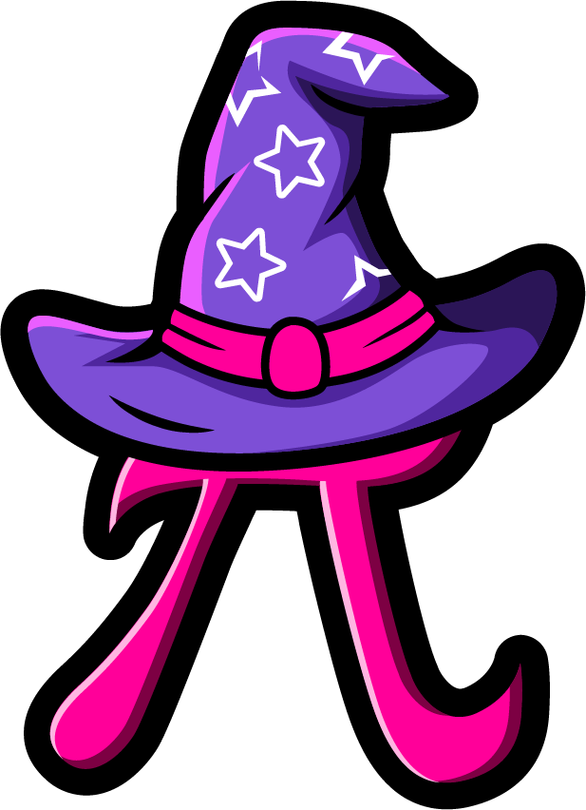
Lesson 3:
Add 2 to a number
www.arithmagicians.com

Slide 2



+
=
+
4
+
2
=
2
+
4
What is the same and what is different?

Slide 3


Solve: 2 + 6
Ayesha:
“I am going to start on 2 and count on 6 times.”
2
3
4
5
6
7
8
Leon:
“I am going to start on 6 and count on 2 times.”
6
7
8
Which is quicker?

Slide 4

2
+
7
=
9
Swap the numbers

Slide 5


Your Turn
9
2 + 7 = ?
7
2) 2 + 5 = ?
Remember
to swap the
numbers if needed.
5
3) 2 + 3 = ?
6
4) 2 + 4 = ?
4
5) 2 + 2 = ?

Slide 6
True or False
2 + 5 and 5 + 2 give the same answer.
True

