Slide 1
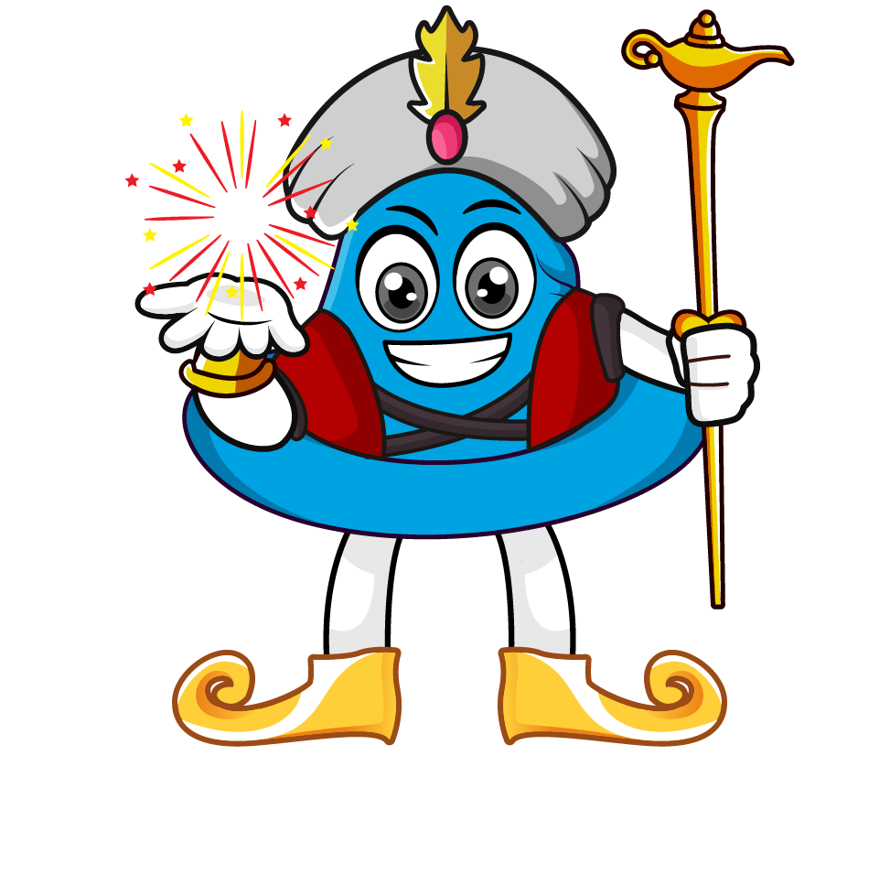
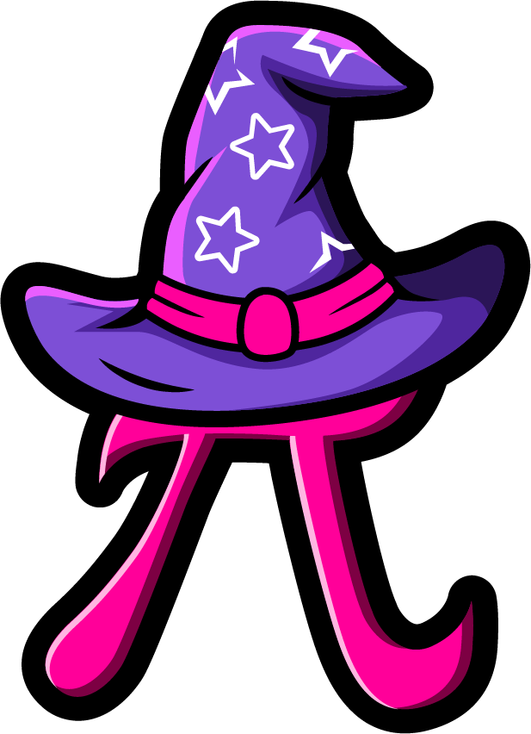
Lesson 3:
Multiply a tenth
by a single digit
www.arithmagicians.com

Slide 2

3 x 0.2 = 0.6
2 x 0.3 = 0.6
0.1
0.1
0.1
0.1
0.1
0.1
0.1
0.1
0.1
0.1
0.1
0.1
What do you notice?
What is the same and what is different?

Slide 3


Decimals can be tricky, so we’ll adjust the question by turning the decimal into a whole number first.
If I multiply 0.8 by 10, it becomes 8.
So we’ll temporarily solve 8 x 3 instead.
We made 0.8 ten times bigger to turn it into 8, so our answer is also ten times too big.
So we compensate by dividing the answer by 10.
0.8 x 3 = ?
2.4
x10
÷10
8 x 3 = ?
24

Slide 4
Let’s recap what we did.
First, adjust the calculation by multiplying the decimal number by 10.
Next, solve the new calculation using whole numbers.
Finally, compensate by dividing the answer by
10 to undo the adjustment made at the start.

Slide 5


Your Turn
1) 2 x 0.4 =
0.8
5) 0.7 x 4 =
2.8
2) 0.2 x 4 =
0.8
6) 7 x 0.4 =
2.8
4.5
7) 0.2 x 7 =
1.4
3) 0.5 x 9 =
4) 5 x 0.9 =
4.5
8) 2 x 0.7 =
1.4
What do you notice?

Slide 6
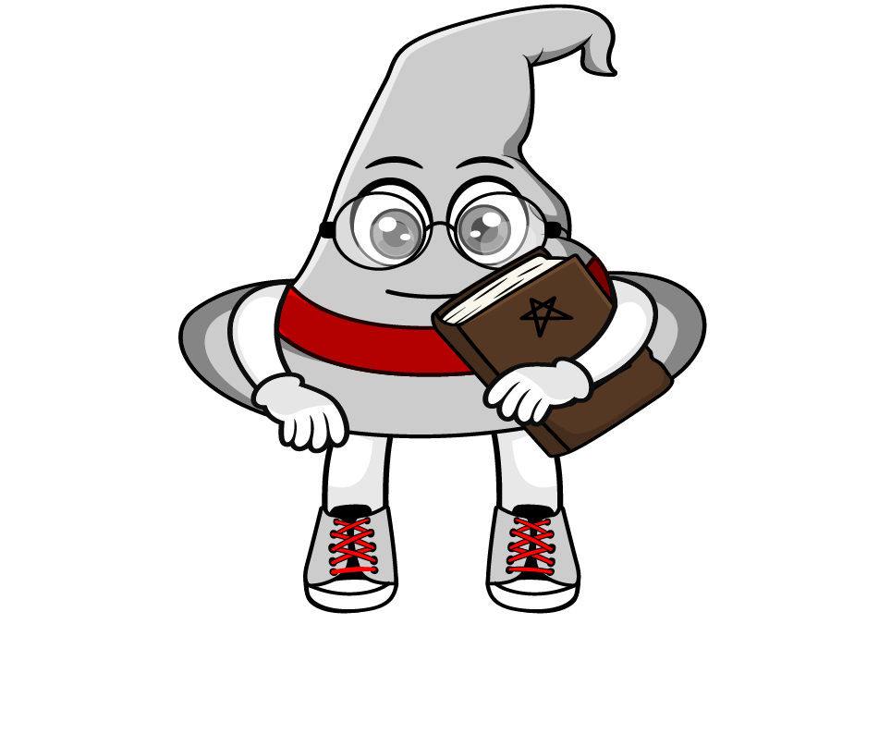
True or False
0.4 x 3 = 4 x 0.3
True: Can you explain why?

