Slide 1
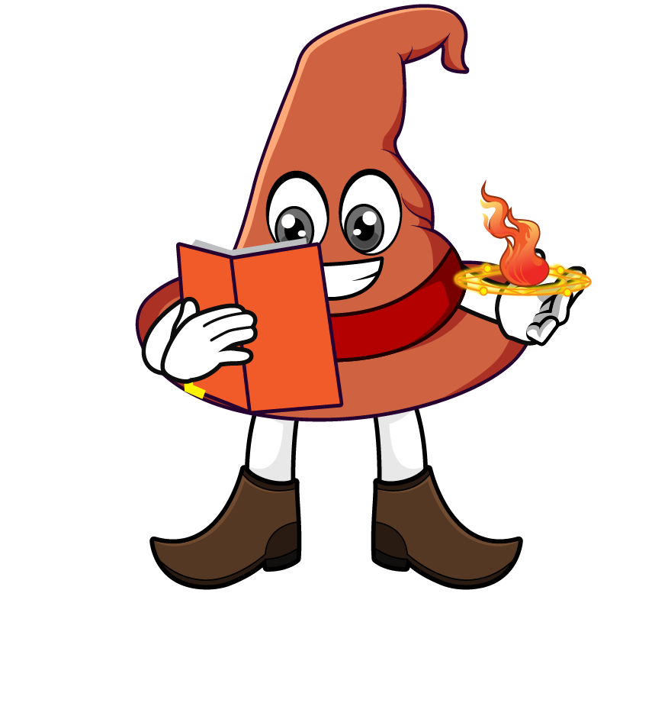

Lesson 4:
Recap: Repeated multiplication by 10
www.arithmagicians.com

Slide 2

Let’s recap what we have learnt so far?
1) To multiply a number by 10 each digit moves
to the left on a place value grid.
1
2) To multiply a number by 100 each digit moves
to the left on a place value grid.
2
3) To multiply a number by 1,000 each digit moves
to the left on a place value grid.
3

Slide 3
Write different calculations that all equal 85000 using
×10 and ×1000
85 x 10 x 10 x 10
85 x 1000
850 x 10 x 10
8500 x 10

Slide 4


Your Turn
1) 63 x 10 =
630
2) 63 x 10 x 10 =
6300
3) 63 x 100 =
6300
4) 63 x 10 x 10 x 10 =
63000
5) 63 x 100 x 10 =
63000
6) 63 x 1000 =
63000

Slide 5

True or False
45 x 100 = 45 x 10 x 10
True

