Slide 1
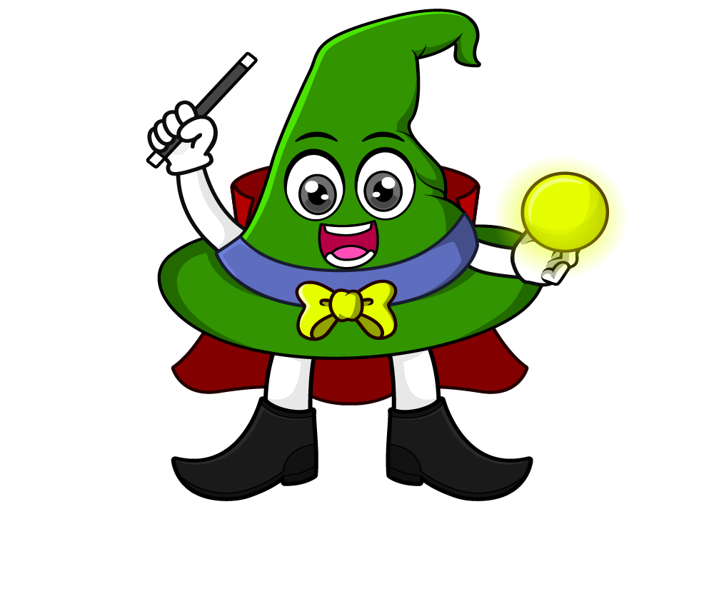
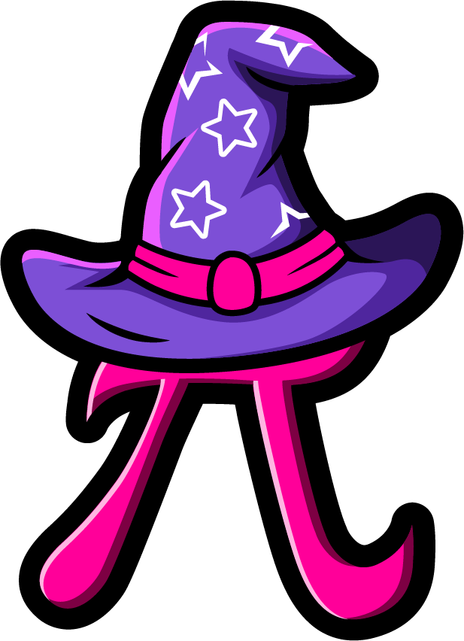
Lesson 4:
Multiply a tenth
by a single digit
www.arithmagicians.com

Slide 2

2 x 0.4 = 0.8
4 x 0.2 = 0.8
0.1
0.1
0.1
0.1
0.1
0.1
0.1
0.1
0.1
0.1
0.1
0.1
0.1
0.1
0.1
0.1
What do you notice?

Slide 3


Decimals can be tricky, so we’ll adjust the question by turning the decimal into a whole number first.
If I multiply 0.7 by 10, it becomes 7.
So we’ll temporarily solve 7 x 3 instead.
We made 0.7 ten times bigger to turn it into 7, so our answer is also ten times too big.
So we compensate by dividing the answer by 10.
0.7 x 3 = ?
2.1
x10
÷10
7 x 3 = ?
21

Slide 4
Let’s recap what we did.
First, adjust the calculation by multiplying the decimal number by 10.
Next, solve the new calculation using whole numbers.
Finally, compensate by dividing the answer by
10 to undo the adjustment made at the start.

Slide 5


Your Turn
1) Each sticker is 0.6 cm long. A strip has 4 stickers placed end to end. How long is the strip altogether?
0.6 × 4 = 2.4 cm
2) One biscuit weighs 0.1 kg. A pack contains 8 biscuits. What is the total weight of the biscuits?
0.1 × 8 = 0.8 kg
3) A ribbon is cut into pieces that are each 0.6 m long. There are 3 pieces. What is the total length of ribbon?
0.6 × 3 = 1.8 m

Slide 6
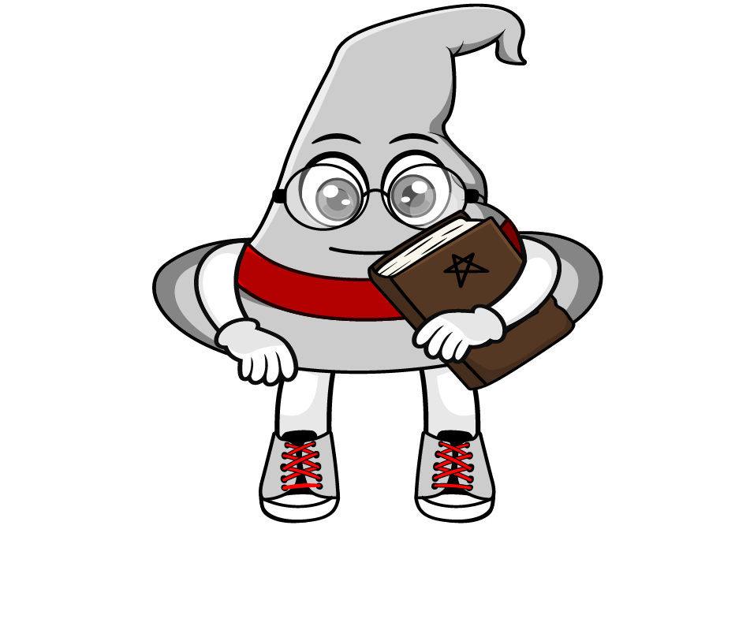
True or False
0.2 x 3 x 10 ÷ 10 = 0.2 x 3
True: Can you explain why?

