Slide 1


Lesson 4
Consolidate strategies for x7 table
www.arithmagicians.com

Slide 2

+7
+7
+7
+7
+7
+7
+7
+7
+7
+7
0
7
14
21
28
35
42
49
56
63
70
Get ready to count up in 7s

Slide 3
There are lots of different strategies for the ×7 table.

Slide 4
Some ×7 facts don’t link neatly to patterns or simple place-value facts, so it is best to learn them off by heart.

Slide 5

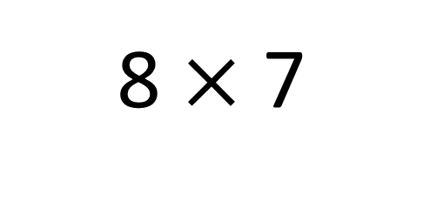
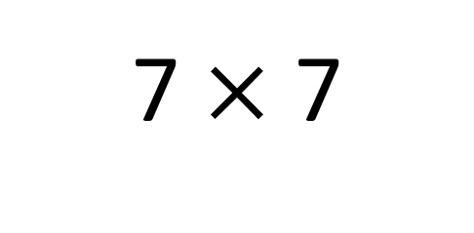
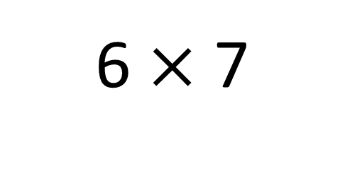
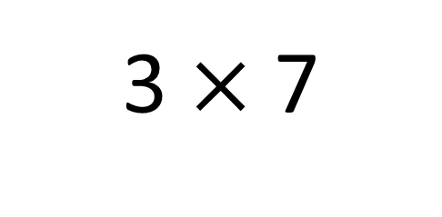
How can we learn the ‘tricky’ x7 tables off by heart?
3 $×$ 7
7 $×$ 7
6 $×$ 7
8 $×$ 7

Slide 6


Your Turn
Focus on:
3 x 7, 6 x 7, 7 x 7 and 8 x 7
“Ping–Pong Recall”
One partner says the question, the other fires back the answer instantly.
Example:
Partner A: “7×7?”
Partner B: “49!”
Then swap.
“Missing Number Challenge”
Partner A gives the answer,
Partner B says the fact.
Example:
A: “42.”
B: “That’s 7×6.”
Then swap.

