Slide 1
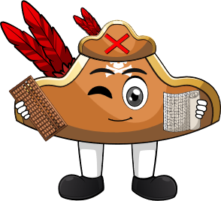

Week 2:
Assess & Review
www.arithmagicians.com

Slide 2



What did we learn this week?
bigger.
When you add 1, the number gets one ______
+
=
2
+
1
=
3

Slide 3
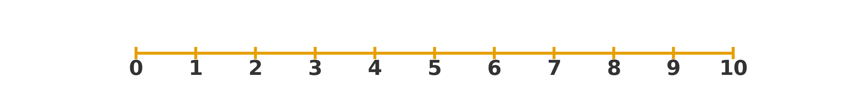
What did we learn this week?
more.
Adding 2 means counting on 2 _______
4
+
2
=
6

Slide 4


What did we learn this week?
swap
You can _______ the numbers around to make
it easier to add.
+
=
+
4
+
2
=
2
+
4

Slide 5


Your Turn
5
1 + 4 = ?
6
2) 4 + 2 = ?
5
3) 2 + 3 = ?
9
4) 7 + 2 = ?
8
5) 2 + 6 = ?

