Slide 1


Lesson 1: Subtract 10
www.arithmagicians.com

Slide 2

-10
-10
-10
-10
-10
-10
-10
-10
-10
10
20
30
40
50
60
70
80
90
100
Get ready to count back in 10s

Slide 3

?
?
10
20
30
40
50
60
70
80
90
100
What are the missing numbers?

Slide 4
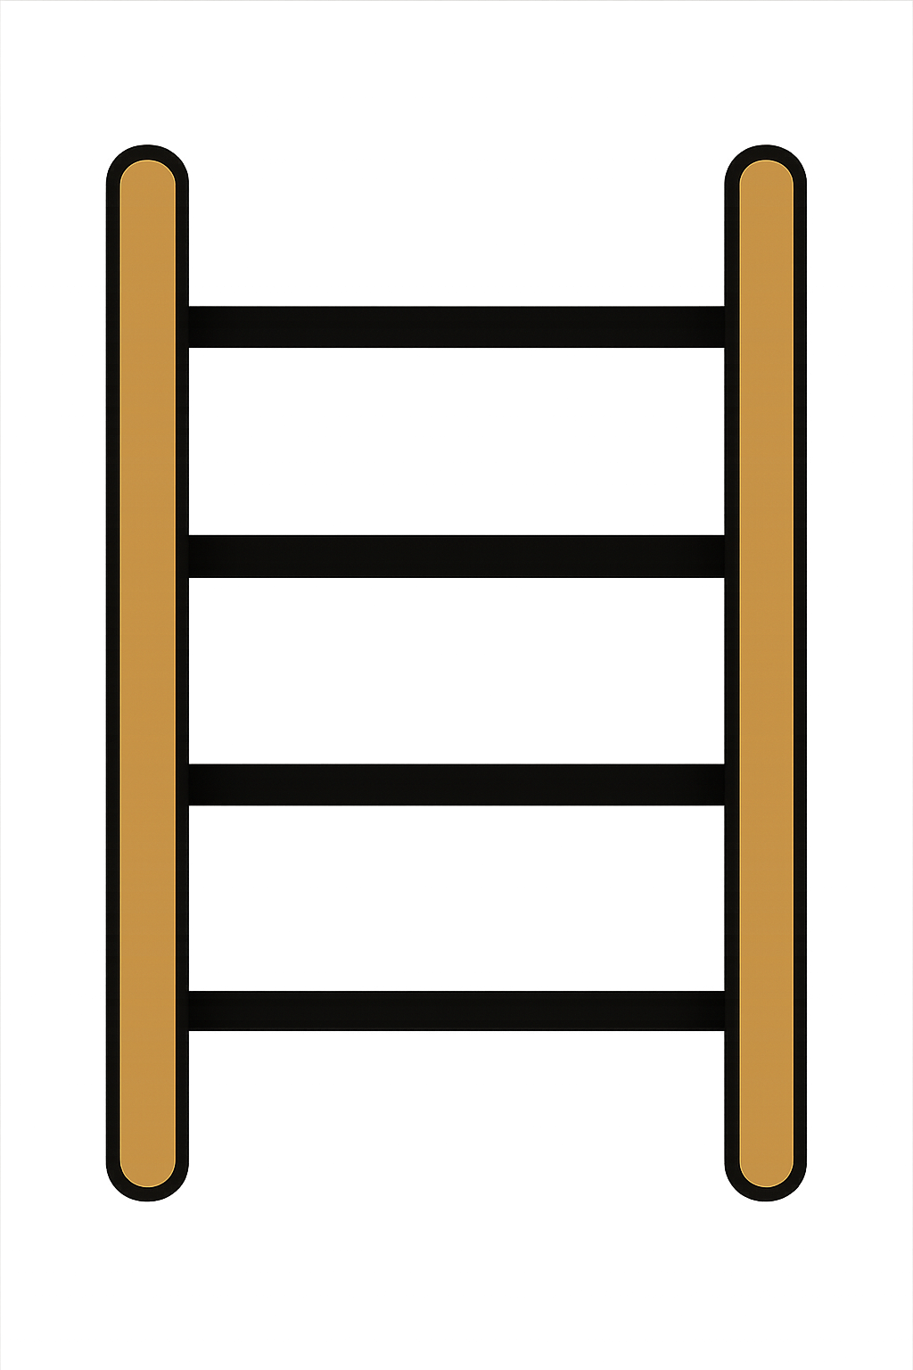
20 - 10
= 10
First, I’m going to show 20 on
the rekenrek.
Now I need to subtract 10.
What do I have left?

Slide 5
30 - 10
= 20
Now I need to subtract 10.
What do I have left?
First, I’m going to show 30 on
the rekenrek.

Slide 6

What do you notice?
20
-
10
=
10
30
-
10
=
20
When you subtract 10 from a number, the tens digit goes down by _____.
one

Slide 7


Your Turn
40
50 - 10 = ?
30
2) 40 - 10 = ?
3) 80 - 10 = ?
70
80
4) 90 - 10 = ?
5) 70 - 10 = ?
60

Slide 8
Always/Sometimes/Never
When you subtract 10 from a number, the number stays the same.
Never

