Slide 1
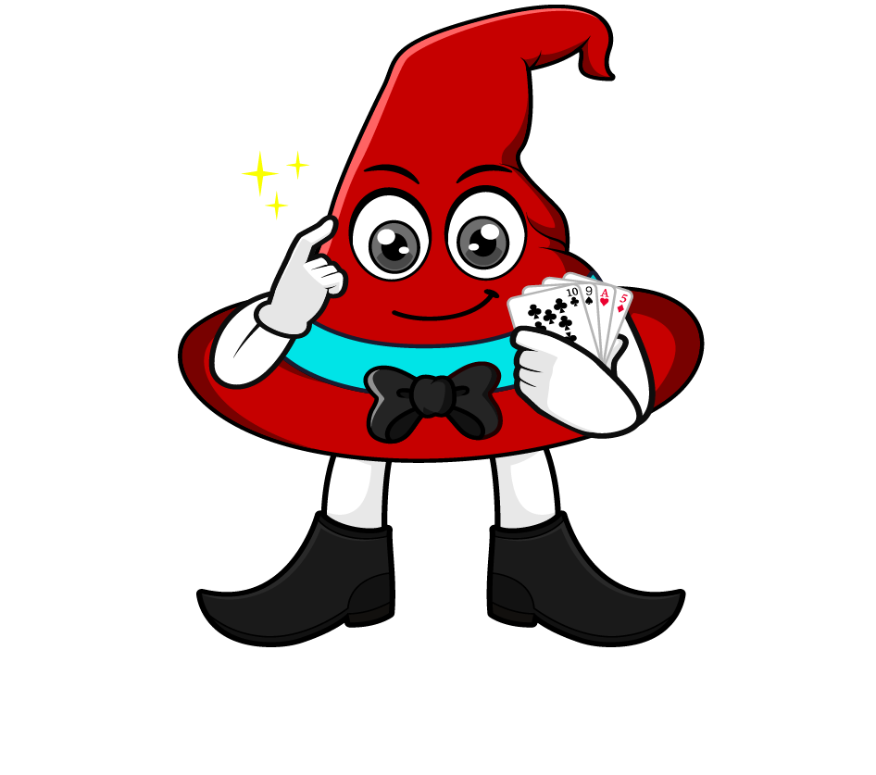

Lesson 1:
Multiply a tenth by a multiple of 10
www.arithmagicians.com

Slide 2


Solve: 0.3 x 20
First, we re-write 20 as 2 × 10
Next, we can solve 0.3 x 2
Finally, we multiply by 10
0.3 x 20
0.3
x 2
x 10
0.6
x 10
6

Slide 3
Let’s recap what we did.
0.3 x 20
First, re-write the multiple of 10
(20 = 2 × 10)
Next, multiply the decimal by the whole number
(0.3 x 2)
Finally, multiply by 10
(0.6 x 10)

Slide 4

0.4 x 70
0.4
x 7
x 10
2.8
x 10
?
28
Finally, we multiply by 10
0.4
7
Next, we can solve ____ x ____
70
7
10
First, we re-write ____ as ___ × ___

Slide 5


Your Turn
1) 0.4 x 20 =
8
2) 0.5 x 30 =
15
12
3) 40 x 0.3 =
4) 80 x 0.6 =
48

Slide 6

True or False
0.2 x 30 = 2 x 3
True: Can you explain why?

