Slide 1


Lesson 1:
7 x 11 Table
www.arithmagicians.com

Slide 2

+7
+7
+7
+7
+7
+7
+7
+7
+7
+7
0
7
14
21
28
35
42
49
56
63
70
Get ready to count up in 7s

Slide 3


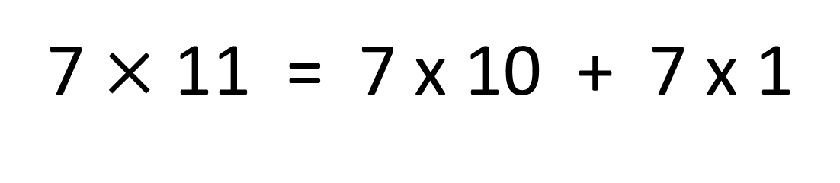

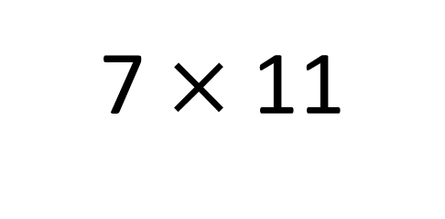
True
True or False
7 $×$ 11
=
7 $×$ 10 + 7 x 1
=
7 $×$ 11 = 7 x 10 + 7 x 1
7
___ groups of 11 is the same as 7 groups
of ____ plus one group of ___
10
7

Slide 4


Your Turn
Answer the questions below and be ready to explain which strategy you used.
35
5) 4 x 7 =
28
1) 5 x 7 =
2) 11 x 7 =
77
6) 8 x 7 =
56
3) 6 x 7 =
42
7) 7 x 11 =
77
4) 3 x 7 =
21
8) 7 x 12 =
84

Slide 5

True or False
7 x 11 = 7 x 10 - 7
False: What mistake did Novice make?

