Slide 1
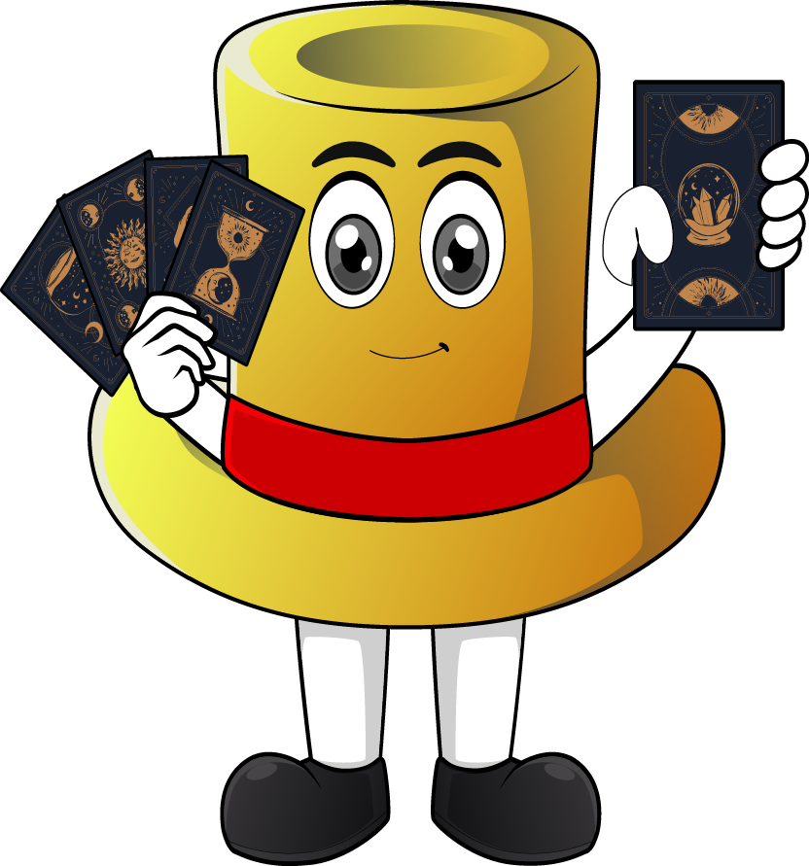

Lesson 2:
8 x 3 table
(using: double + one more group strategy)
www.arithmagicians.com

Slide 2

+3
+3
+3
+3
+3
+3
+3
+3
+3
+3
0
3
6
9
12
15
18
21
24
27
30
Get ready to count up in 3s

Slide 3

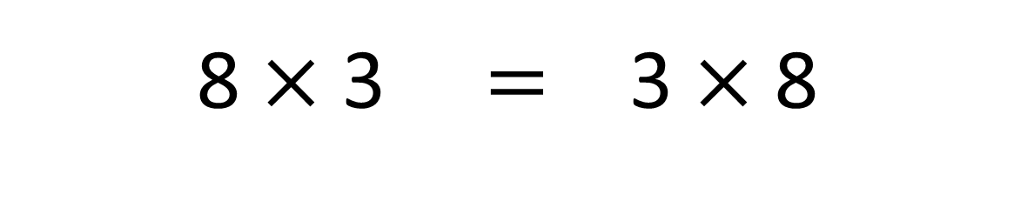
True
Recap: True or False
8 $×$ 3 $=$ 3 $×$ 8

Slide 4

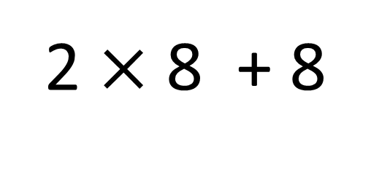
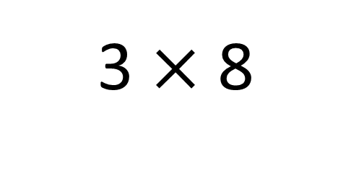
True
True or False
3 $×$ 8
=
2 $×$ 8 + 8
=
3
__ groups of 8 is the same as 2 groups of __ plus __ more
8
8

Slide 5


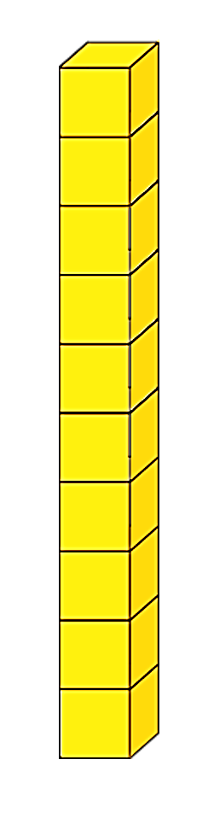
Great! What do I need to do first?
What do I do next?
I wan to solve 3 x 8 using the ‘double and one more group’ strategy.
Can you help?
+
+
+ 8 more
Double 8
= 24

Slide 6


Your Turn
Do you have a different strategy?
Which strategy do you prefer? Why?
Show 3 different ways of solving 3 x 8
Skip count in 8s, three times
Double + one more
group strategy
+8
+8
+8
3 x 8 = 2 x 8 + 8
0
8
16
24
Skip count in 3s, eight times
+3
+3
+3
+3
+3
+3
+3
+3
0
3
6
9
12
15
18
21
24

