Slide 1


Lesson 2: Subtract 10
www.arithmagicians.com

Slide 2

-10
-10
-10
-10
-10
-10
-10
-10
-10
10
20
30
40
50
60
70
80
90
100
Get ready to count back in 10s

Slide 3

?
?
10
20
30
40
50
60
70
80
90
100
What are the missing numbers?

Slide 4
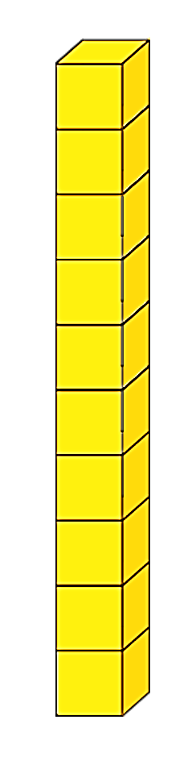
80 - 10
= 70
Now I need to subtract 10.
What do I have left?
First, I’m going to make 80

Slide 5


90
100 - 10 = ?
What do I need to do first.
What do I have left?
Now I can subtract one 10.
First, I exchange 100 for ten 10s

Slide 6
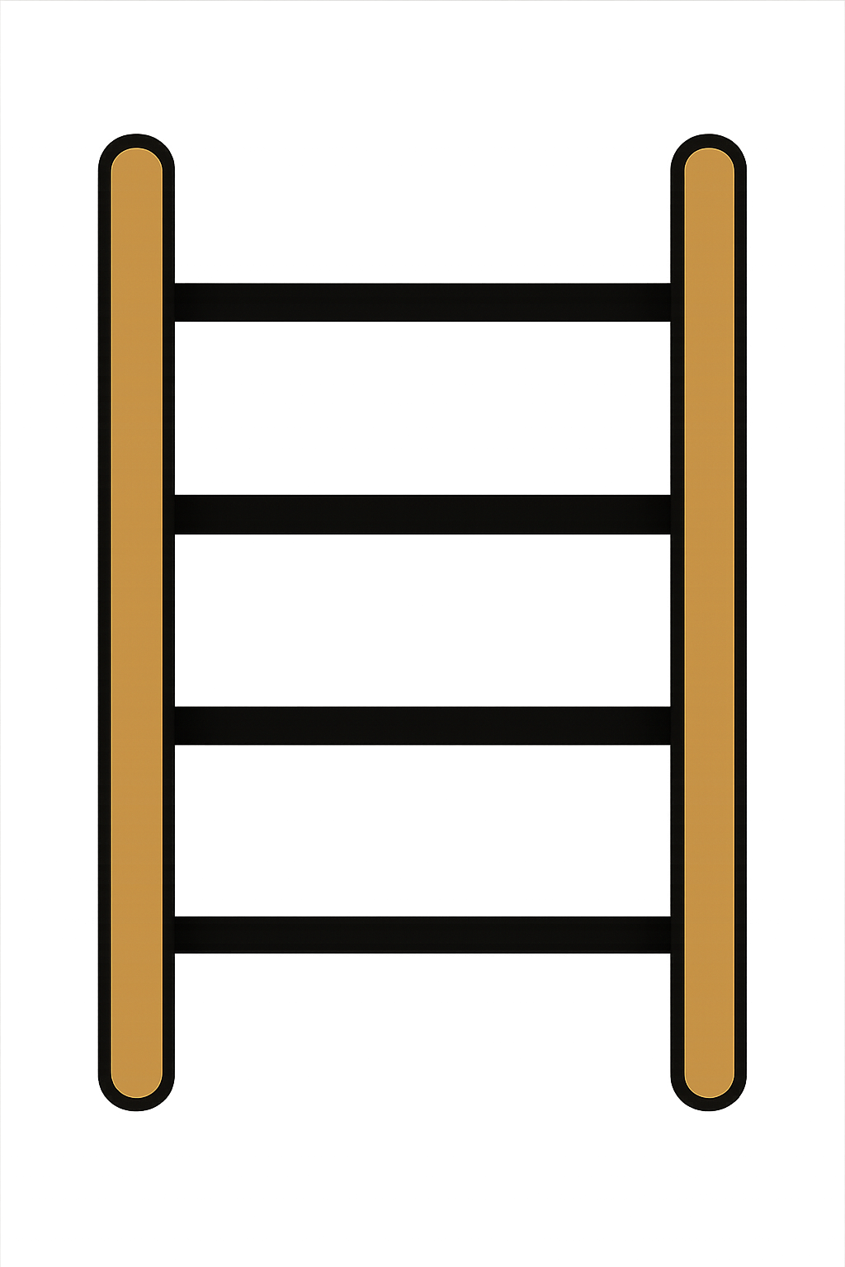
40 - 10
= 30
What do I have left?
First, I’m going to show 40 on
the rekenrek.
Now I need to subtract 10.

Slide 7
What do you notice?
80
-
10
=
70
40
-
10
=
30
ten
When you subtract ____ from a number, the tens digit goes down by _____.
one

Slide 8


Your Turn
80
90 - 10 = ?
40
2) 50 - 10 = ?
3) 70 - 10 = ?
60
50
4) 60 - 10 = ?
5) 100 - 10 = ?
90

Slide 9
True or False
When you subtract 10, the number gets smaller
False

