Slide 1
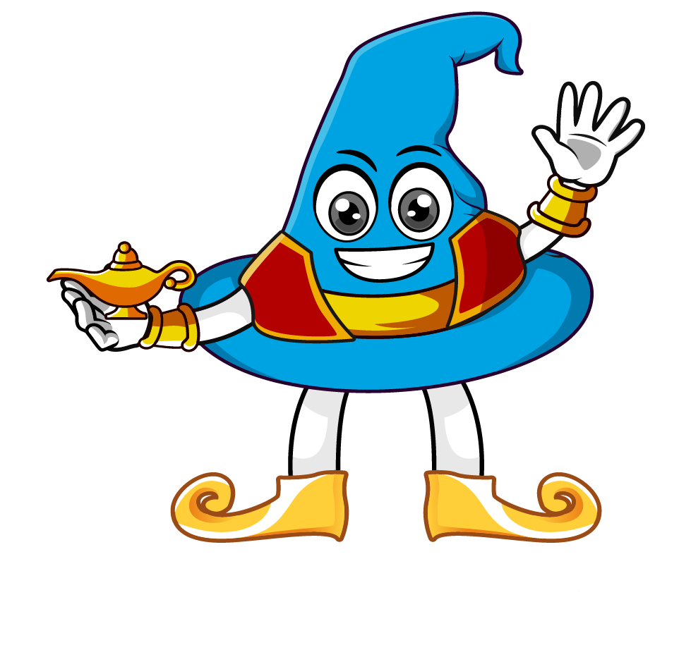

Lesson 2:
To find missing numbers when
multiplying by 1,000
www.arithmagicians.com

Slide 2

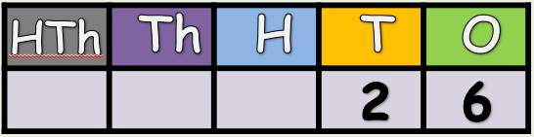

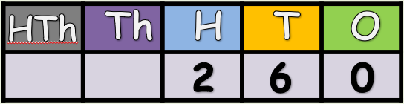
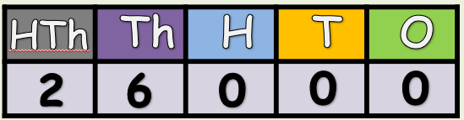
What is the missing number:
x 10
x ?
x 100
x ?

Slide 3
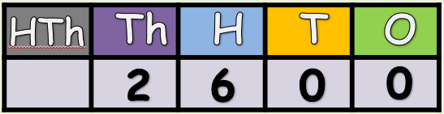
What is the missing number:
5
x ?
x 100
5

Slide 4
What is the missing number:
5
x ?
x 1000
5

Slide 5
Solve:
99 x 100 = 9900
Solve:
99 x ? = 9900
I know that multiplying 99 by _____ gives 9900,
so the missing number is _____.
100
100

Slide 6
Solve:
16 x ? = 16000
Solve:
16 x 1000 = 16000
I know that multiplying 16 by _____ gives 16000,
so the missing number is _____.
1000
1000

Slide 7


Your Turn
10
1) 73 x ? = 730
100
2) 99 x ? = 9900
1000
3) ? x 85 = 85000
100
4) ? x 10 = 1000
10
5) 66 x 100 x ? = 66000
100
6) 83 x ? x 10 = 83000

Slide 8

True or False
550 x 10 = 55 x 10 x 10
True: Can you explain why?

