Slide 1


Lesson 3: Subtract 10 from any number
www.arithmagicians.com

Slide 2

-10
-10
-10
-10
-10
-10
-10
-10
-10
10
20
30
40
50
60
70
80
90
100
Get ready to count back in 10s

Slide 3
-10
-10
-10
-10
-10
-10
-10
-10
-10
5
15
25
35
45
55
65
75
85
95
Get ready to count back in 10s

Slide 4

?
?
5
15
25
35
45
55
65
75
85
95
What are the missing numbers?

Slide 5
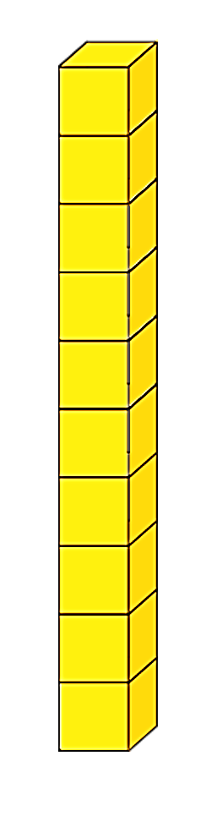

43 - 10
= 33
What do I have left?
Now I need to subtract 10.
First, I’m going to make 43

Slide 6
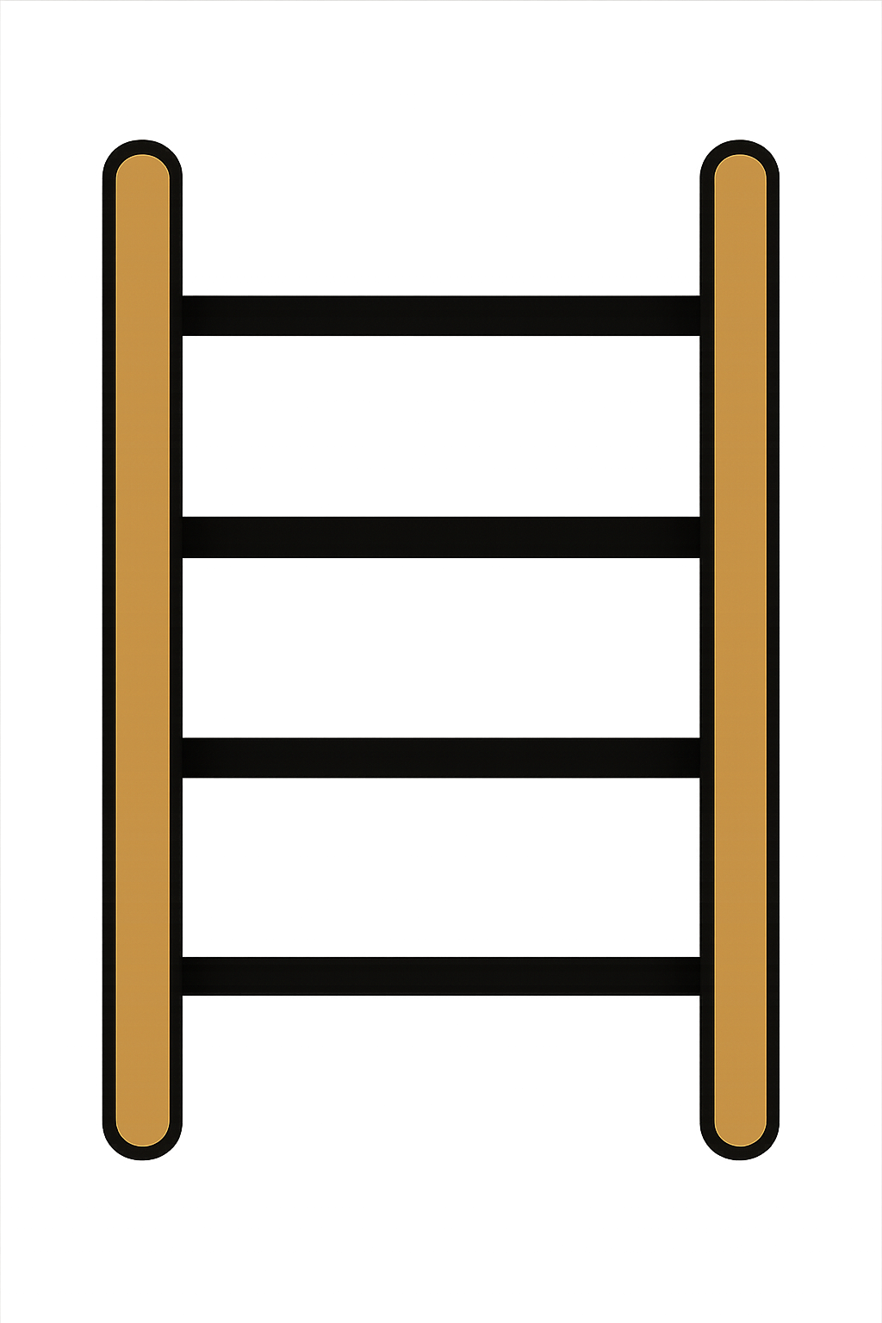
35 - 10
= 25
First, I’m going to show 35 on
the rekenrek.
Now I need to subtract 10.
What do I have left?

Slide 7

What do you notice?
43
-
10
=
33
35
-
10
=
25
When you subtract 10 from a number, the _____ digit decreases but the ones digit stays the ____
tens
same.

Slide 8


Your Turn
26
36 - 10 = ?
45
2) 55 - 10 = ?
3) 71 - 10 = ?
61
18
4) 28 - 10 = ?
5) 84 - 10 = ?
74

Slide 9
True or False
When you subtract 10, the ones digit changes.
False

