Slide 1


Lesson 4:
3 x 9 table
www.arithmagicians.com

Slide 2

+3
+3
+3
+3
+3
+3
+3
+3
+3
+3
0
3
6
9
12
15
18
21
24
27
30
Get ready to count up in 3s

Slide 3





3
There are ____ groups.
3
9
There are ____ equal groups of ____
9
There are ____ in each group.
9
9
9
27
____ $+$ ____ $+$ ____ $=$ ____
27
There are ____ altogether.
27
____ $×$ ____ $=$ ____
3
9
3
9
27
____ $×$ ____ $=$ ____

Slide 4


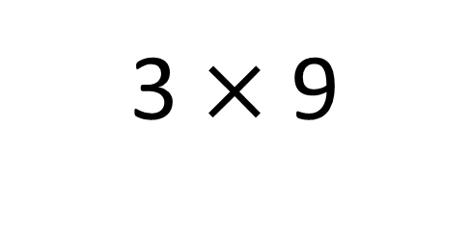
True
True or False
3 $×$ 9
=
3 $×$ 10 - 3 x 1
=
3
___ groups of 9 is the same as 3 groups
of ____ minus one group of ___
10
3

Slide 5


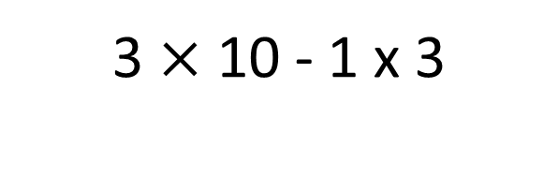
Solve: 9 x 3
Jasmin:
I am going to skip count in 9s, three times.
+9
+9
+9
0
9
18
27
Amy:
I will find 3 groups of 10, then subtract 1 group of 3.
3 $×$ 10 - 1 x 3
30 - 3
27
Which method do you prefer – why?

Slide 6


Your Turn
Answer the questions below and be ready to explain which strategy you used.
12
4) 6 x 3 =
18
1) 3 x 4 =
24
27
2) 8 x 3 =
5) 9 x 3 =
3) 3 x 9 =
27
6) 7 x 3 =
21

Slide 7

True or False
3 x 9 = 3 x 3 x 3
True

