Slide 1
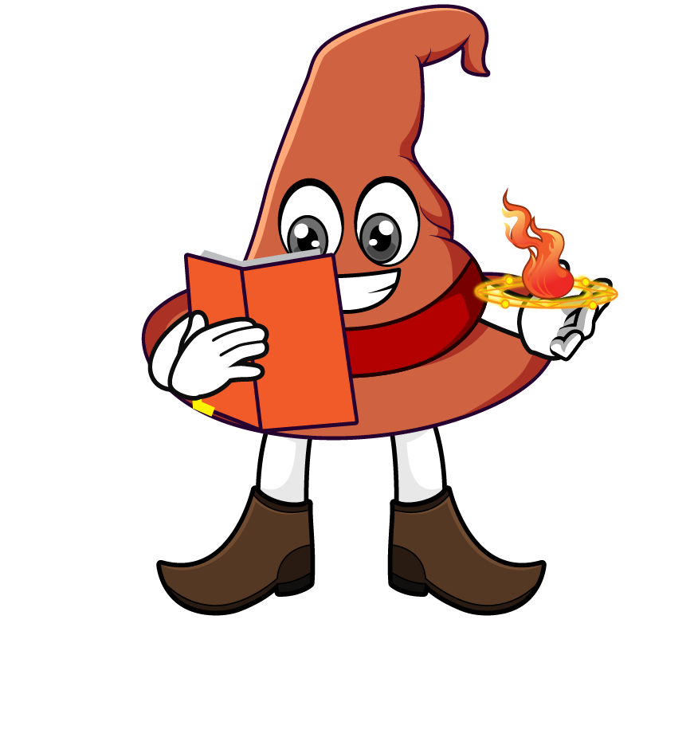

Lesson 4:
Multiply a tenth by a multiple of 10
www.arithmagicians.com

Slide 2

Which strategy do you prefer? Why?
0.7 x 60
= 0.7 x 10 x 6
= 7 x 6
= 42
= 0.7 x 6 x 10
= 4.2 x 10
= 42

Slide 3


Your Turn
1) A pencil is 0.1 m long. What is the total length of 30 pencils placed end to end?
0.1 × 30 = 3 m
2) A toy car travels 0.4 km in one minute. How far does it travel in 20 minutes?
0.4 × 20 = 8 km
3) A plant grows 0.6 cm each day. How much does it grow in 70 days?
0.6 × 70 = 42 cm

Slide 4
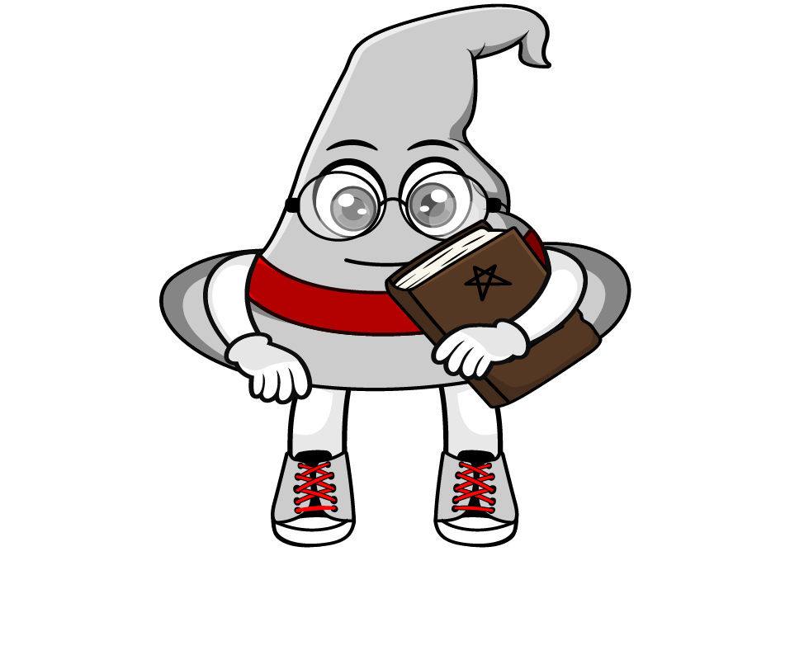
True or False
Multiplying a number by 0.1 makes it 10 times smaller.
True

