Slide 1


Lesson 5:
Assess and Review
www.arithmagicians.com

Slide 2

+3
+3
+3
+3
+3
+3
+3
+3
+3
+3
0
3
6
9
12
15
18
21
24
27
30
Get ready to count up in 3s

Slide 3
-3
-3
-3
-3
-3
-3
-3
-3
-3
3
6
9
12
15
18
21
24
27
30
Get ready to count back in 3s

Slide 4

We have learnt two strategies to help
us solve 3 multiplied by 4, 5, 6, 7 and 8.
skip
We can use _____ counting or
______ + one more group strategy.
double

Slide 5
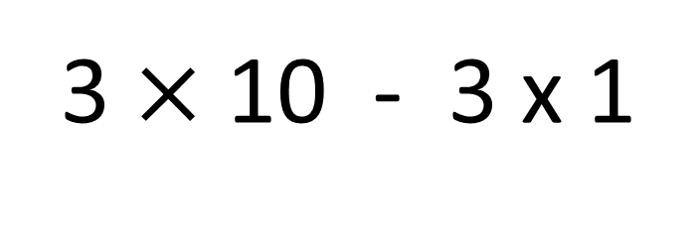
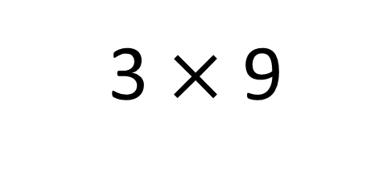
3 $×$ 9
=
3 $×$ 10 - 3 x 1
=
3
To work out 3 × 9, we can make ___
groups of ____ and then subtract one
group of ____.
10
3

Slide 6


Your Turn
1) 3 x 3 =
9
6) 7 x 3 =
21
2) 3 x 6 =
18
7) 3 x 8 =
24
3) 2 x 3 =
6
8) 1 x 3 =
3
4) 3 x 4 =
12
9) 9 x 3 =
27
5) 5 x 3 =
15
10) 3 x 0 =
0

