Slide 1


Lesson 5:
Assess and Review
www.arithmagicians.com

Slide 2



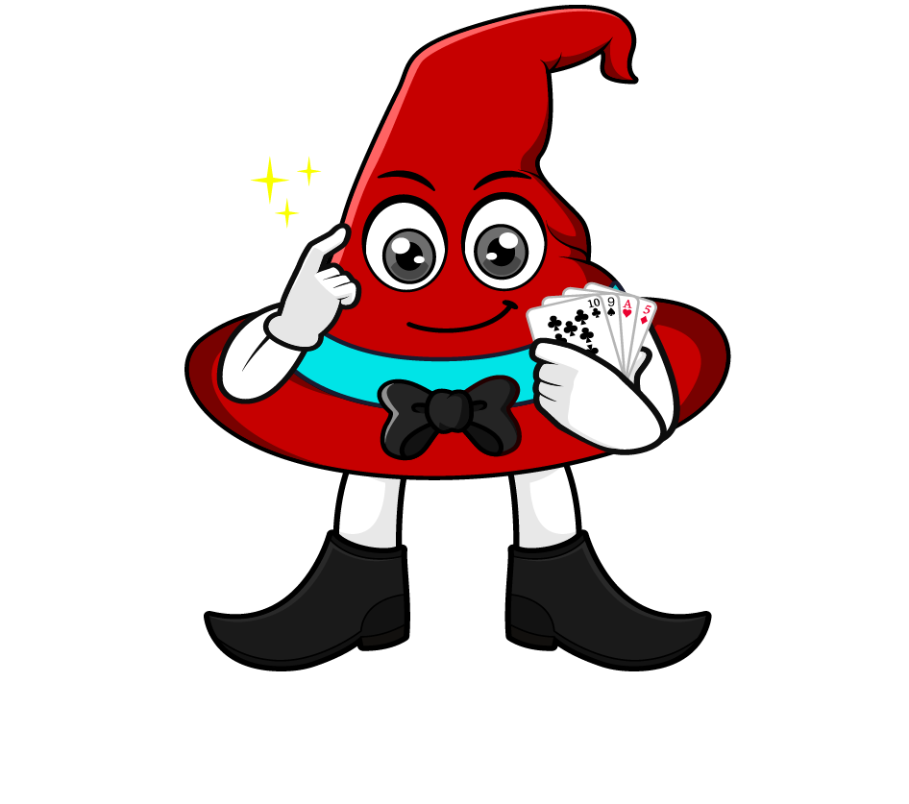
0.6 x 80
I will multiply 0.6 by 10 to make a whole number, then multiply by 8.
= 0.6 x 10 x 8
= 6 x 8
= 48
What’s the same & What’s different?
I will multiply 0.6 by 8 first, then multiply by 10.
= 0.6 x 8 x 10
= 4.8 x 10
= 48

Slide 3
Which strategy do you prefer? Why?
0.3 x 80
= 0.3 x 10 x 8
= 3 x 8
= 24
= 0.3 x 8 x 10
= 2.4 x 10
= 24

Slide 4


Your Turn
1) 60 x 0.4 =
24
5) 0.8 x 40 =
32
2) 0.2 x 40 =
8
6) 70 x 0.4 =
28
63
7) 0.7 x 70 =
49
3) 70 x 0.9 =
4) 0.5 x 90 =
45
8) 30 x 0.7 =
21

