Slide 1


Lesson 1:
11 x 3 table
www.arithmagicians.com

Slide 2

-3
-3
-3
-3
-3
-3
-3
-3
-3
3
6
9
12
15
18
21
24
27
30
Get ready to count back in 3s

Slide 3





3
There are ____ groups.
3
11
There are ____ equal groups of ____
11
There are ____ in each group.
11
11
11
33
____ $+$ ____ $+$ ____ $=$ ____
33
There are ____ altogether.
33
____ $×$ ____ $=$ ____
3
11
3
11
33
____ $×$ ____ $=$ ____

Slide 4

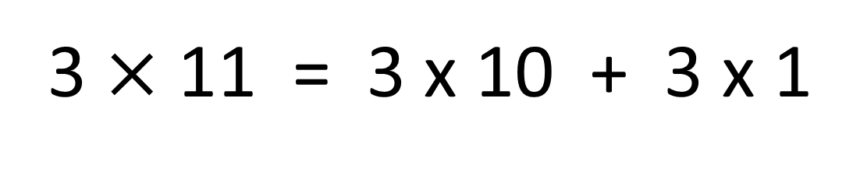

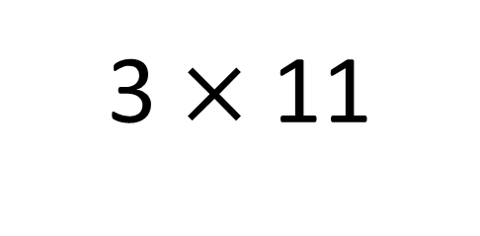
True
True or False
3 $×$ 11
=
3 $×$ 11 = 3 x 10 + 3 x 1
3 $×$ 10 + 3 x 1
=
3
___ groups of 11 is the same as 3 groups
of ____ plus one group of ___
10
3

Slide 5

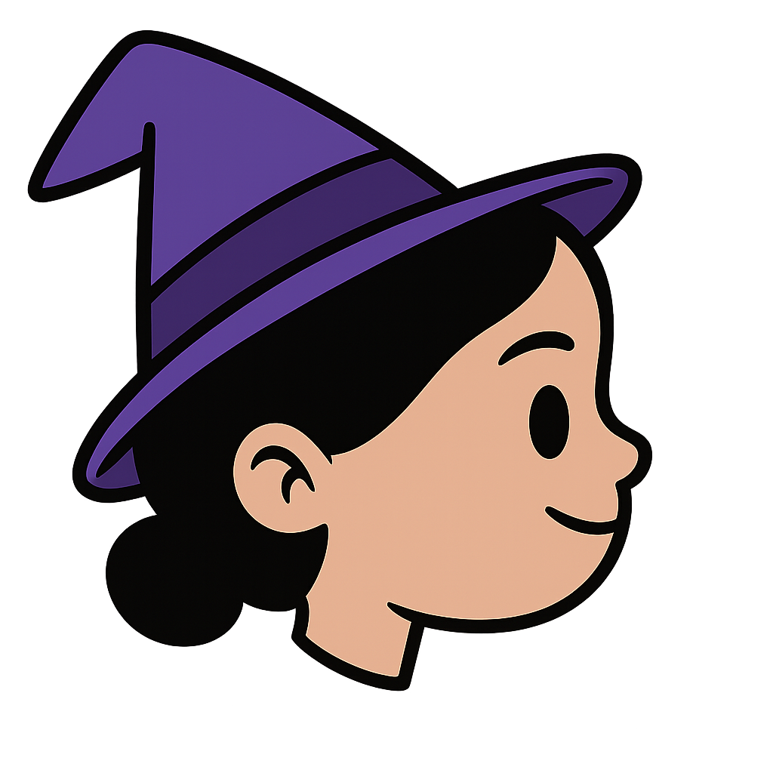
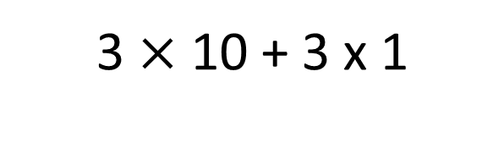
Solve: 11 x 3
Amy:
I am going to skip count in 11s, three times.
+11
+11
+11
0
11
22
33
3 $×$ 10 + 3 x 1
Jasmin:
I will find 3 groups of 10, then add 1 group of 3.
30 + 3
33
Which method do you prefer – why?

Slide 6


Your Turn
Answer the questions below and be ready to explain which strategy you used.
24
4) 6 x 3 =
18
1) 8 x 3 =
33
21
2) 11 x 3 =
5) 3 x 7 =
3) 3 x 9 =
27
6) 3 x 4 =
12

Slide 7

True or False
3 x 11 = 3 x 10 - 3
False: What mistake did Novice make?

