Slide 1
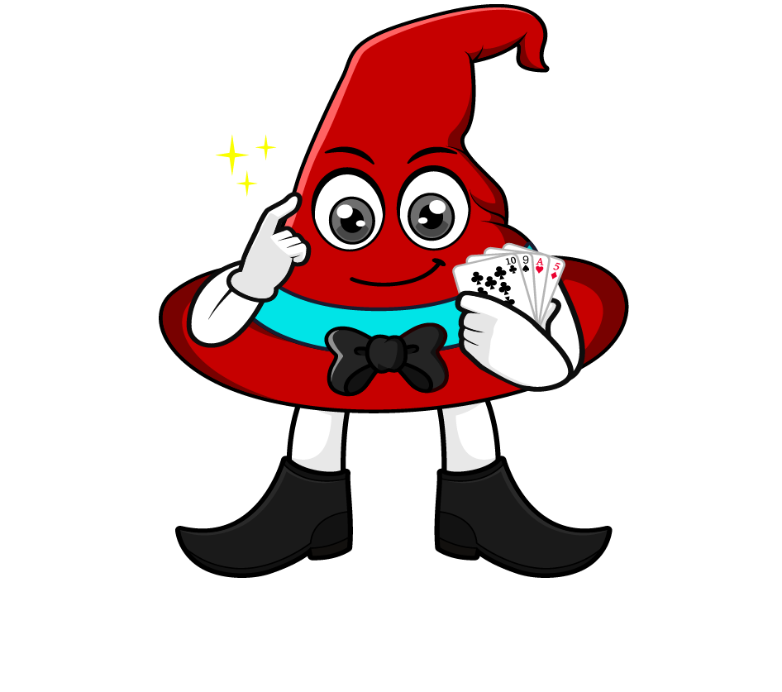

Lesson 1:
Divide by 1000
www.arithmagicians.com

Slide 2

Let’s recap what we have learnt so far?
1) To divide a number by 10 each digit moves
to the right on a place value grid.
1
2) To divide a number by 100 each digit moves
to the right on a place value grid.
2
3) To divide a number by 1,000 each digit moves
to the right on a place value grid.
3

Slide 3


When we divide by 1000, every digit moves three place to the right.
The place value chart shows the number 85,000
So we now have 85
85000 ÷ 1000 = 85
.
HTh
Th
H
T
O
t
h
th
.
8
5
8
0
5
8
0
0
5
0
0
0
0
0
0

Slide 4

______ divided by 1,000 is equal to _______
839
5
839,000
66
66,000
5,000

Slide 5


Your Turn
1) 5200 ÷ 100 =
52
5) 88000 ÷ 10 =
8800
2) 99000 ÷ 1000 =
99
6) 88000 ÷ 100 =
880
3) 72000 ÷ 1000 =
72
7) 88000 ÷ 1000 =
88
626
6
4) 6260 ÷ 10 =
8) 6000 ÷ 1000 =

Slide 6

True or False
To divide a number by 1,000, each digit moves three places to the left on a place-value grid.
False: What mistake did Rookie make?

