Slide 1
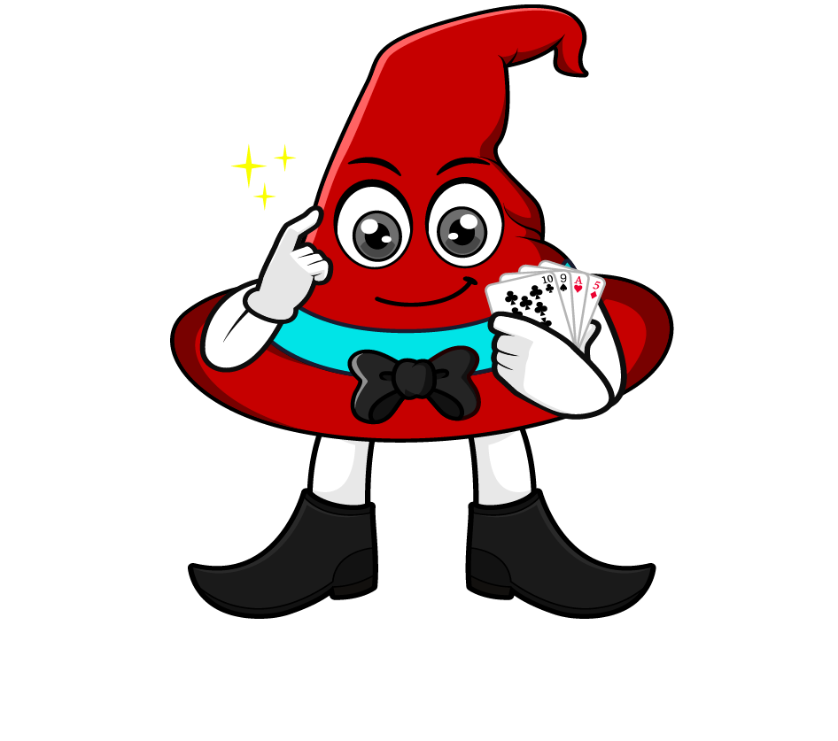

Lesson 1:
Multiply a tenth by a
multiple of 100
www.arithmagicians.com

Slide 2


First, we re-write 200 as 2 × 100
Finally, we multiply by 100
Next, we can solve 0.3 x 2
Solve: 0.3 x 200
0.3 x 200
0.3
x 2
x 100
0.6
x 100
60

Slide 3
Let’s recap what we did.
0.3 x 200
First, re-write the multiple of 100
(200 = 2 × 100)
Next, multiply the decimal by the whole number
(0.3 x 2)
Finally, multiply by 100
(0.6 x 100)

Slide 4

0.4 x 700
0.4
x 7
x 100
?
x 100
2.8
280
700
0.4
7
100
7
First, we re-write ____ as ___ × ___
Next, we can solve ____ x ____
Finally, we multiply by 100

Slide 5


Your Turn
1) 0.4 x 200 =
80
2) 0.5 x 300 =
150
120
3) 400 x 0.3 =
4) 800 x 0.6 =
480

Slide 6
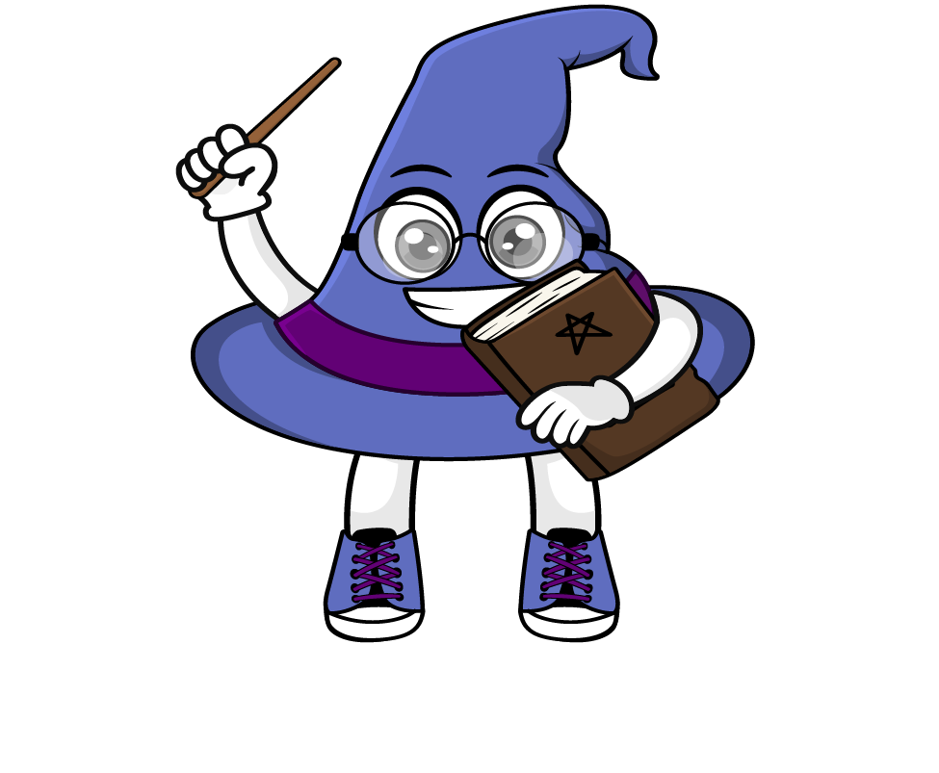
True or False
0.2 x 300 = 2 x 30
True: Can you explain why?

