Slide 1
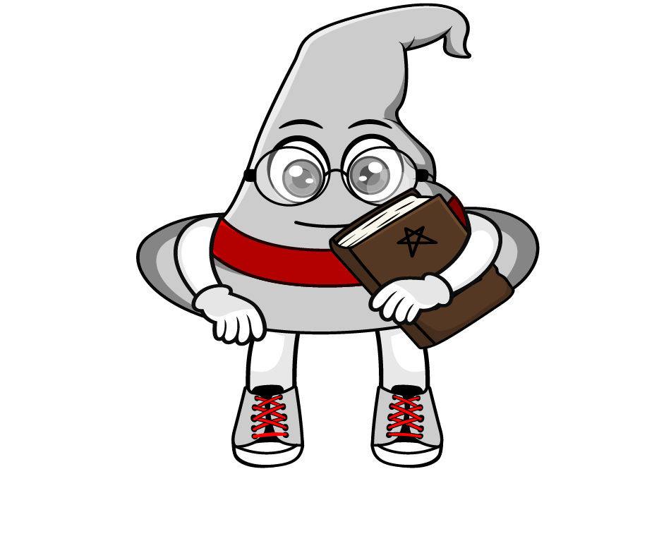
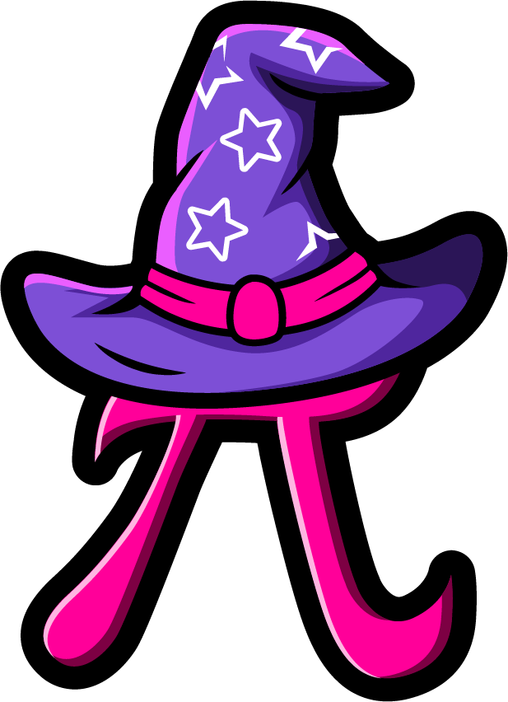
Lesson 2:
Multiply a tenth by a
multiple of 100
www.arithmagicians.com

Slide 2



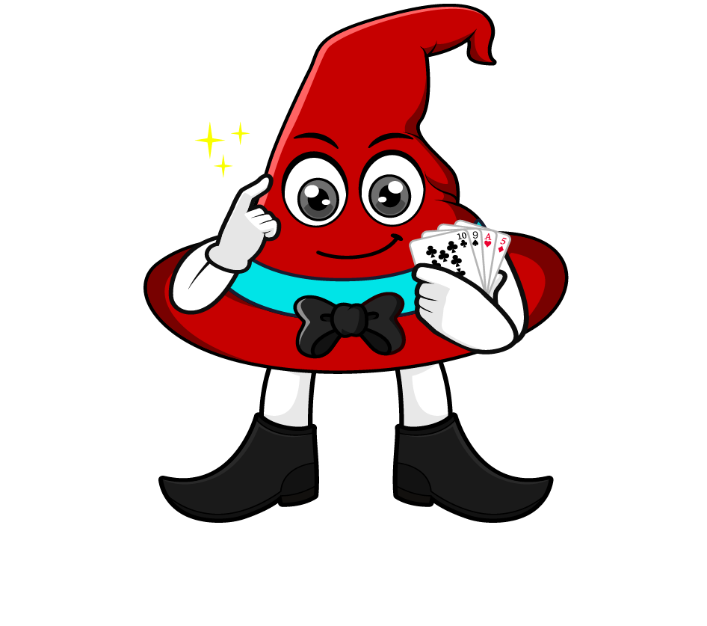
0.4 x 200
I will multiply 0.4 by 100 to make a whole number, then multiply by 2.
= 0.4 x 100 x 2
= 40 x 2
= 80
What’s the same & what’s different?
I will multiply 0.4 by 2 first, then multiply by 100.
= 0.4 x 2 x 100
= 0.8 x 100
= 80

Slide 3
Which strategy do you prefer? Why?
0.3 x 600
= 0.3 x 100 x 6
= 30 x 6
= 180
= 0.3 x 6 x 100
= 1.8 x 100
= 180

Slide 4


Your Turn
Be prepared to share your strategy
1) 0.6 x 400 =
240
2) 0.7 x 800 =
560
3) 900 x 0.3 =
270
4) 700 x 0.7 =
490
5) 600 x 0.9 =
540

Slide 5
True or False
0.2 x 800
Multiplying by 8 first makes the calculation easier because it removes the decimal.
False: What mistake did Rookie make?

