Slide 1


Lesson 3:
Recap Strategies for the x 3 tables
www.arithmagicians.com

Slide 2

-3
-3
-3
-3
-3
-3
-3
-3
-3
3
6
9
12
15
18
21
24
27
30
Get ready to count back in 3s

Slide 3
There are lots of different strategies for the ×3 table.

Slide 4
There are lots of different strategies for the ×3 table.
Some ×3 facts don’t link neatly to patterns or simple place-value facts, so it is best to learn them off by heart.

Slide 5

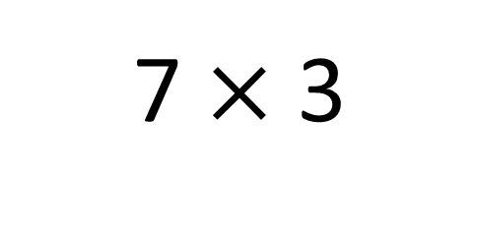
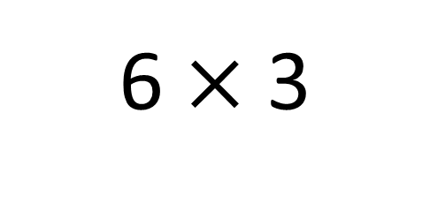
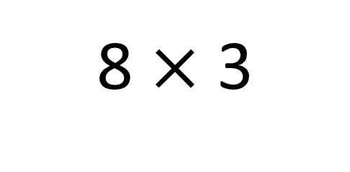
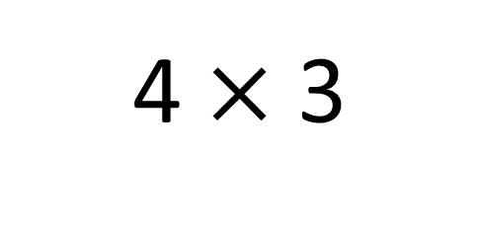
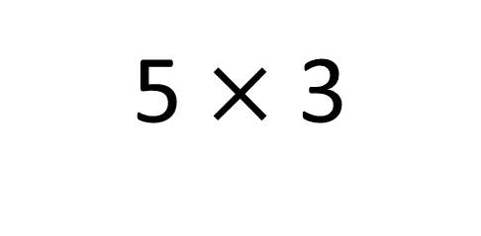
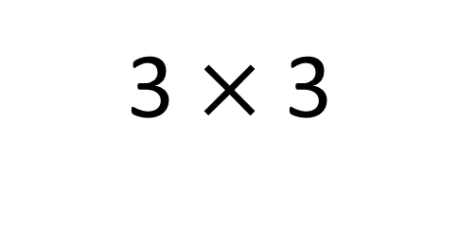
How can we learn the ‘tricky’ x3 tables off by heart?
3 $×$ 3
6 $×$ 3
4 $×$ 3
7 $×$ 3
5 $×$ 3
8 $×$ 3

Slide 6


Your Turn
Focus on:
3 x 3, 4 x 3, 5x 3, 6x 3, 7 x 3 and 8 x 7
“Ping–Pong Recall”
One partner says the question, the other fires back the answer instantly.
Example:
Partner A: “7×7?”
Partner B: “49!”
Then swap.
“Missing Number Challenge”
Partner A gives the answer,
Partner B says the fact.
Example:
A: “42.”
B: “That’s 7×6.”
Then swap.

Slide 7

True or False
3 x 12 = 3 x 10 + 3 x 2
True

