Slide 1
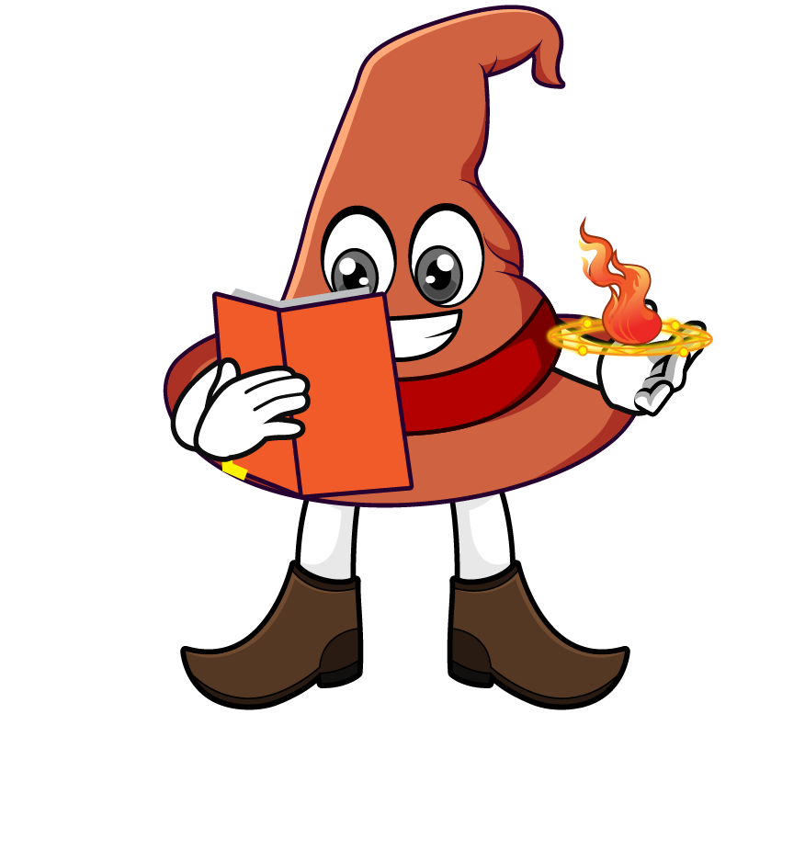

Lesson 4:
Repeated division by 10
(÷ 10 ÷ 10 ÷ 10)
www.arithmagicians.com

Slide 2

Complete the sequence
33000
_________
÷ 10
3300
_________
÷ 10
330
_________
÷ 10
33
_________

Slide 3
10
10
1) 8,300 ÷ ___ ÷ ___ = 83
10
10
10
2) 83,000 ÷ ___ ÷ ___ ÷ ___ = 83
100
10
3) 83,000 ÷ ____ ÷ ___ = 83
4) 83,000 ÷ ______ = 83
1000

Slide 4


Your Turn
630
1) 63,000 ÷ 10 ÷ 10 =
630
2) 63,000 ÷ 100 =
3) 63,000 ÷ 10 ÷ 10 ÷ 10 =
63
4) 63,000 ÷ 100 ÷ 10 =
63
5) 63,000 ÷ 1000 =
63

Slide 5

True or False
5 = 5000 ÷ 10 ÷ 10 ÷ 10
True

