Slide 1
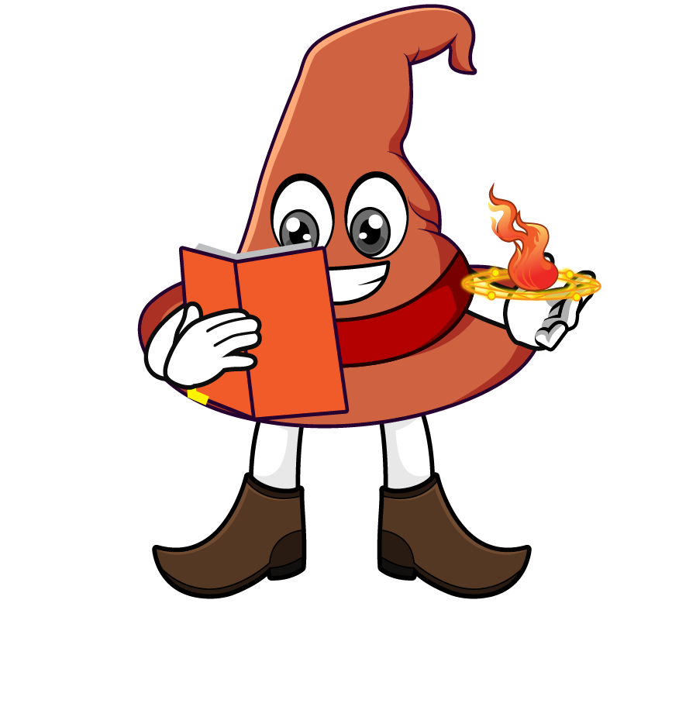
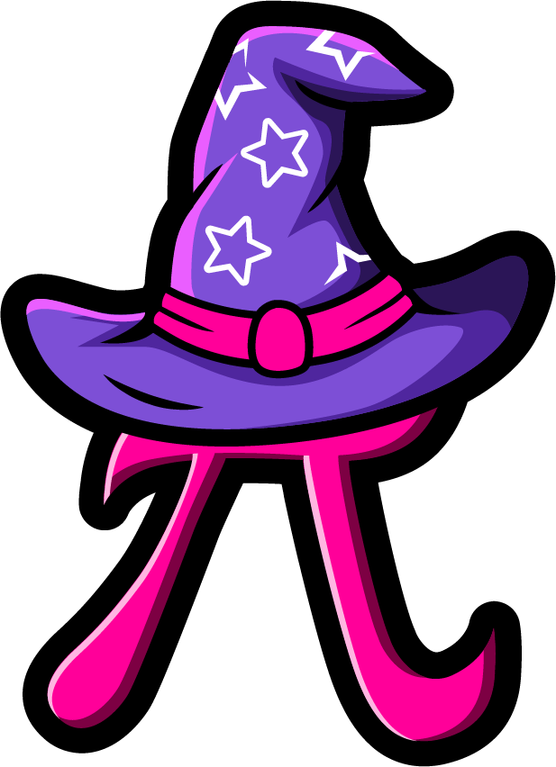
Lesson 4:
Multiply a tenth by a
multiple of 100
www.arithmagicians.com

Slide 2

Which strategy do you prefer? Why?
0.7 x 600
= 0.7 x 100 x 6
= 70 x 6
= 420
= 0.7 x 6 x 100
= 4.2 x 100
= 420

Slide 3


Your Turn
1) A pen is 0.1 m long. What is the total length of 300 pens placed end to end?
0.1 × 300 = 30 m
2) A toy car travels 0.4 km in one minute. How far does it travel in 200 minutes?
0.4 × 200 = 80 km
3) A flower grows 0.6 cm each day. How much does it grow in 800 days?
0.6 × 800 = 480 cm

Slide 4
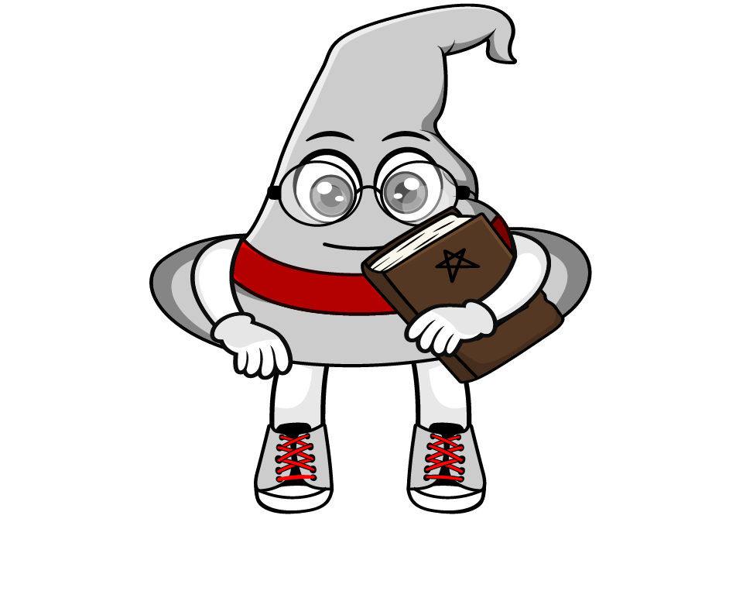
True or False
Multiplying a number by 0.1 is the same as dividing it by 10.
True: Can you explain why?

