Slide 1

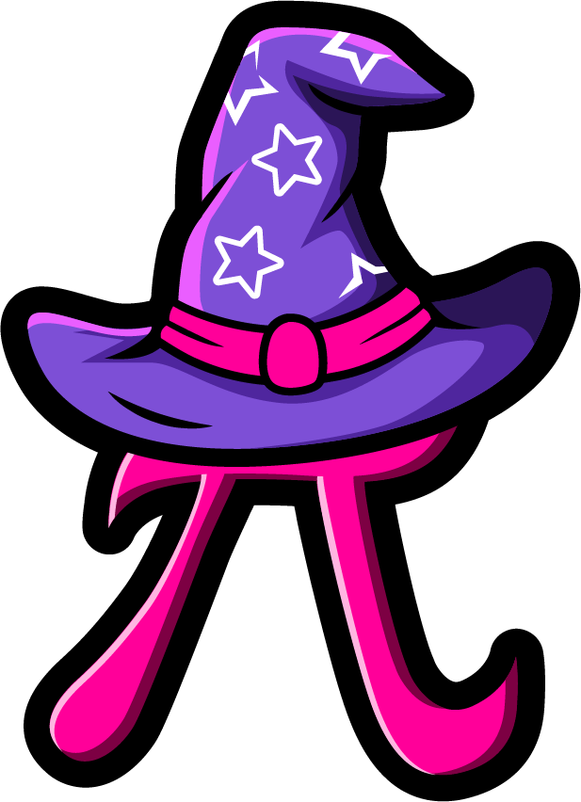
Lesson 5:
Assess and Review
www.arithmagicians.com

Slide 2



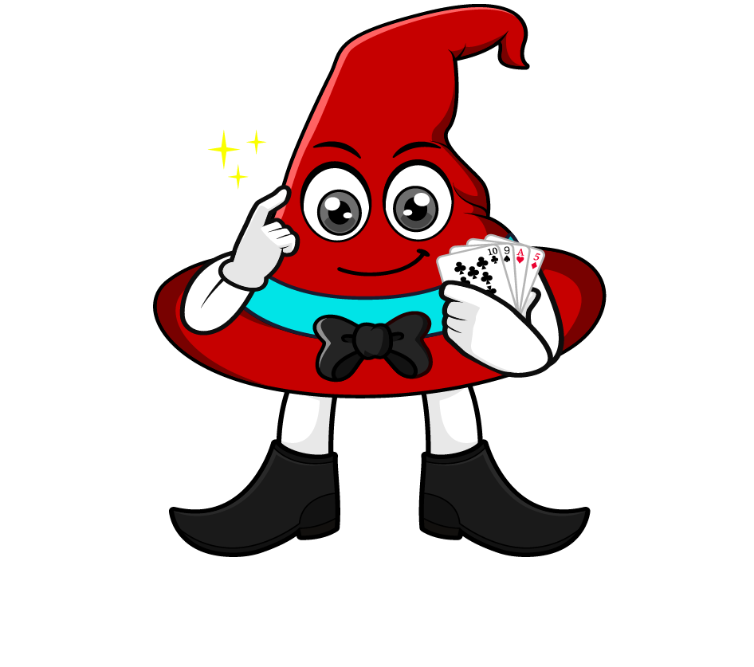
0.6 x 800
I will multiply 0.6 by 100 to make a whole number, then multiply by 8.
= 0.6 x 100 x 8
= 60 x 8
= 480
What’s the same & What’s different?
I will multiply 0.6 by 8 first, then multiply by 100.
= 0.6 x 8 x 100
= 4.8 x 100
= 480

Slide 3
Which strategy do you prefer? Why?
0.3 x 800
= 0.3 x 100 x 8
= 30 x 8
= 240
= 0.3 x 8 x 100
= 2.4 x 100
= 240

Slide 4


Your Turn
1) 600 x 0.4 =
240
5) 0.8 x 400 =
320
2) 0.2 x 400 =
80
6) 700 x 0.4 =
280
630
7) 0.7 x 700 =
490
3) 700 x 0.9 =
4) 0.5 x 900 =
450
8) 300 x 0.7 =
210

