Slide 1

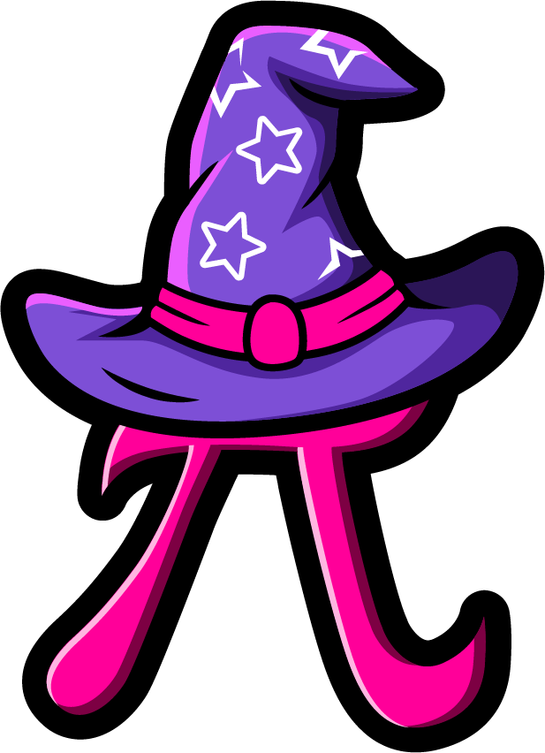
Lesson 1: Add 10
(missing numbers)
www.arithmagicians.com

Slide 2

+10
+10
+10
+10
+10
+10
+10
+10
+10
2
12
22
32
42
52
62
72
82
92
Get ready to count up in 10s

Slide 3

37
27
10
The whole is ____.
One part is ___ and
the other part is ___.
37
27
10

Slide 4

37
27
10
37
27 + 10 = ?
10
27 + ? = 37
27
? + 10 = 37

Slide 5


Your Turn
Draw a bar model to show:
36 + 10 = 46
46
36
10

Slide 6
Your Turn
46
36
10
46
36 + 10 = ?
10
36 + ? = 46
36
? + 10 = 46

Slide 7
True or False
98
88
10
98 + 10 = 88
False

