Slide 1
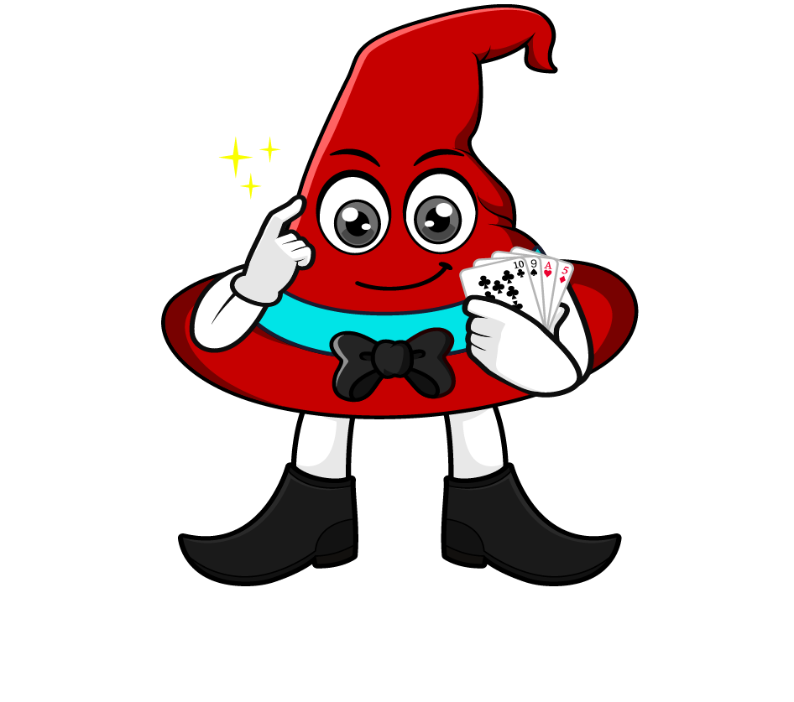

Lesson 1:
Multiply a tenth by a
multiple of 1000
www.arithmagicians.com

Slide 2


Solve: 0.3 x 2000
First, we re-write 2000 as 2 × 1000
Next, we can solve 0.3 x 2
Finally, we multiply by 1000
0.3 x 2000
0.3
x 2
x 1000
0.6
x 1000
600

Slide 3
Let’s recap what we did.
0.3 x 2000
First, re-write the multiple of 1000
(2000 = 2 × 1000)
Next, multiply the decimal by the whole number
(0.3 x 2)
Finally, multiply by 1000
(0.6 x 1000)

Slide 4

0.4 x 7000
0.4
x 7
x 1000
?
x 1000
2.8
2800
Finally, we multiply by 1000
7
0.4
1000
7000
7
First, we re-write _____ as ___× ___
Next, we can solve ____ x ____

Slide 5


Your Turn
1) 0.4 x 2000 =
800
2) 0.5 x 3000 =
1500
1200
3) 4000 x 0.3 =
4) 8000 x 0.6 =
4800

Slide 6
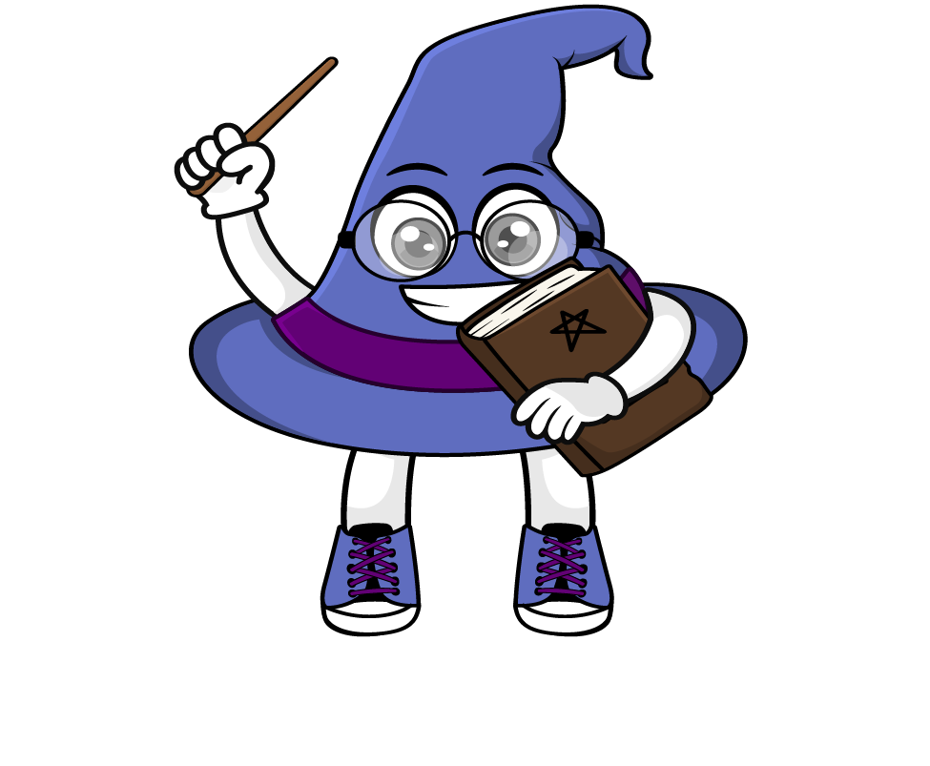
True or False
0.2 x 3000 = 2 x 300
True: Can you explain why?

