Slide 1

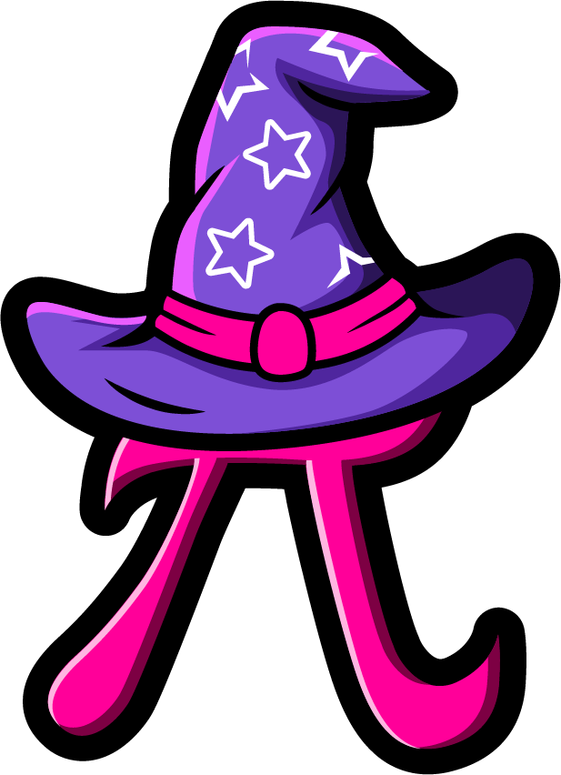
Lesson 2:
Multiply a tenth by a
multiple of 1000
www.arithmagicians.com

Slide 2



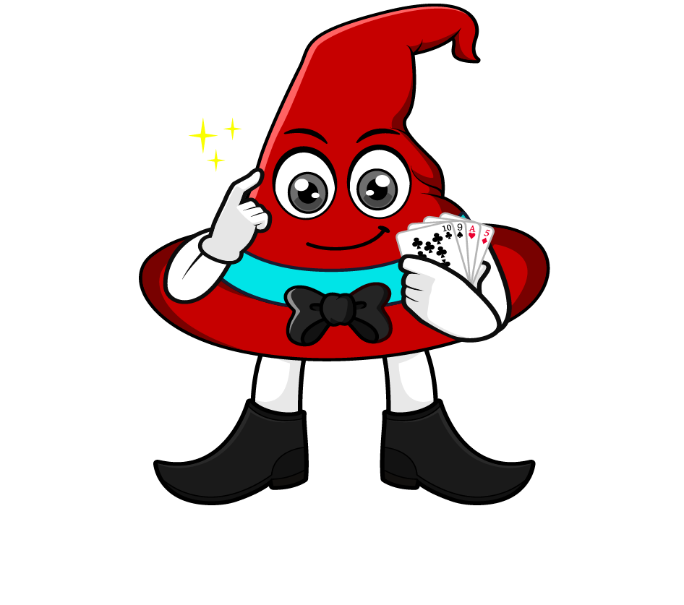
0.4 x 2000
I will multiply 0.4 by 1000 to make a whole number, then multiply by 2.
= 0.4 x 1000 x 2
= 400 x 2
= 800
What’s the same & what’s different?
I will multiply 0.4 by 2 first, then multiply by 1000.
= 0.4 x 2 x 1000
= 0.8 x 1000
= 800

Slide 3
Which strategy do you prefer? Why?
0.3 x 6000
= 0.3 x 1000 x 6
= 300 x 6
= 1800
= 0.3 x 6 x 1000
= 1.8 x 1000
= 1800

Slide 4


Your Turn
Be prepared to share your strategy
1) 0.6 x 4000 =
2400
2) 0.7 x 8000 =
5600
3) 9000 x 0.3 =
2700
4) 7000 x 0.7 =
4900
5) 6000 x 0.9 =
5400

Slide 5
True or False
0.4 x 8000
Multiplying by 8 first makes the calculation easier because it removes the decimal.
False: What mistake did Rookie make?

