Slide 1
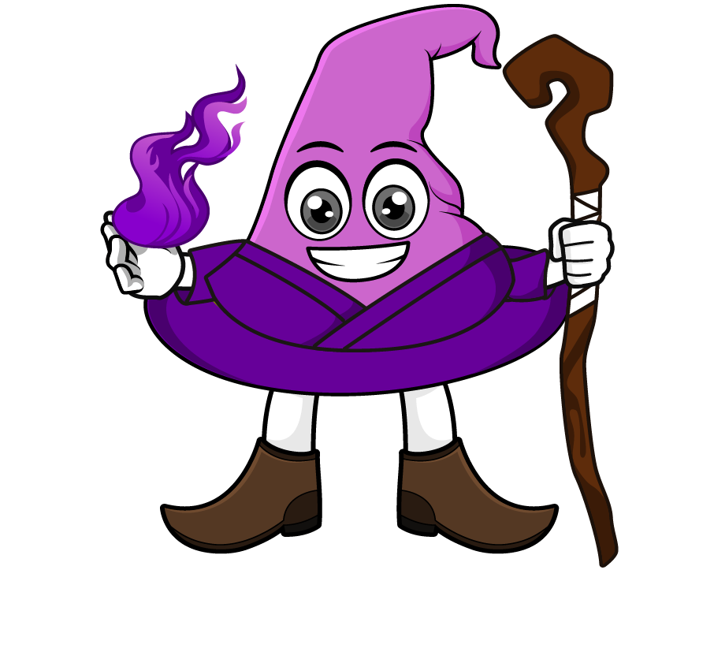
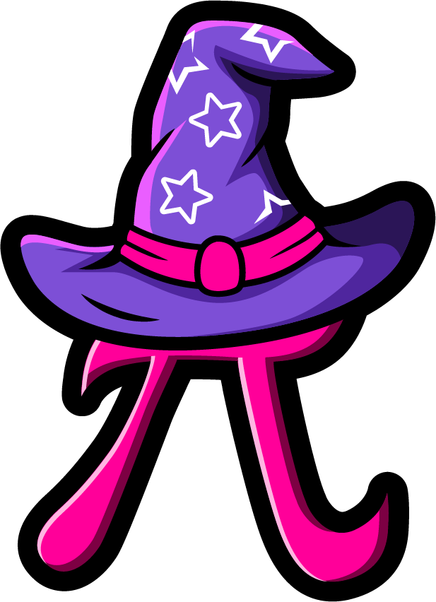
Lesson 3:
Multiply a tenth by a
multiple of 1000
www.arithmagicians.com

Slide 2



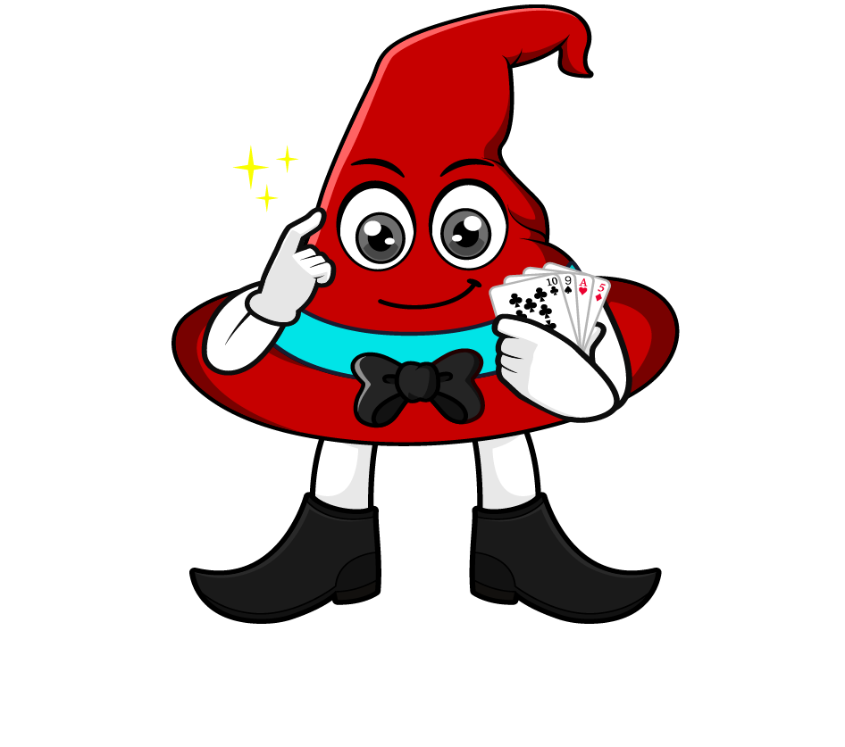
0.3 x 6000
I will multiply 0.3 by 1000 to make a whole number, then multiply by 6.
= 0.3 x 1000 x 6
= 300 x 6
= 1800
What’s the same & what’s different?
I will multiply 0.3 by 6 first, then multiply by 1000.
= 0.3 x 6 x 1000
= 1.8 x 1000
= 1800

Slide 3
Which strategy do you prefer? Why?
0.9 x 8000
= 0.9 x 1000 x 8
= 900 x 8
= 7200
= 0.9 x 8 x 1000
= 7.2 x 1000
= 7200

Slide 4


Your Turn
1) 2000 x 0.4 =
800
5) 0.7 x 4000 =
2800
2) 0.2 x 4000 =
800
6) 7000 x 0.4 =
2800
4500
7) 0.2 x 7000 =
1400
3) 5000 x 0.9 =
4) 0.5 x 9000 =
4500
8) 2000 x 0.7 =
1400
What do you notice?

Slide 5
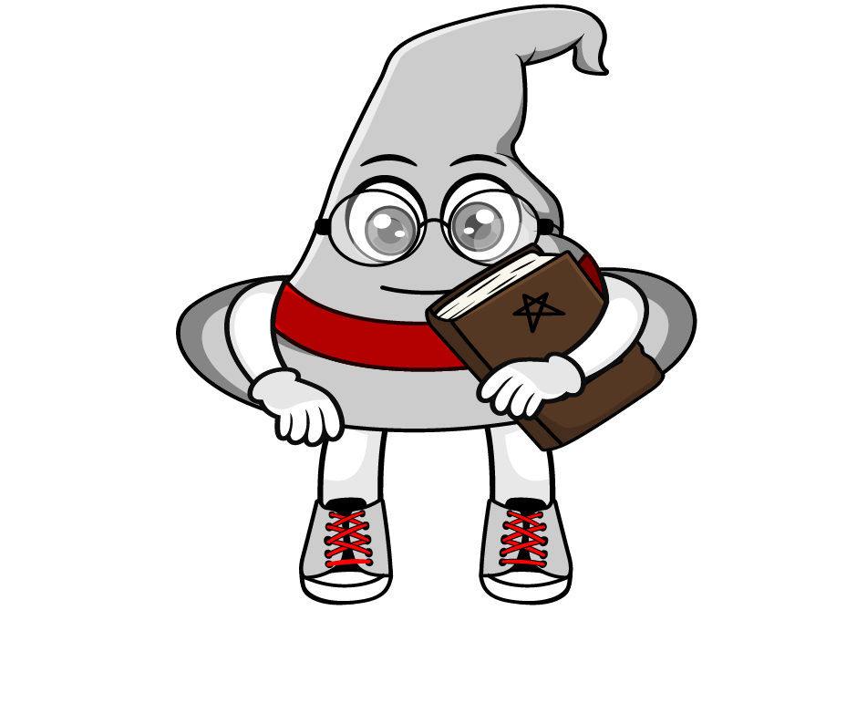
True or False
0.5 x 4000 = 4000 ÷ 2
True: Can you explain why?

