Slide 1
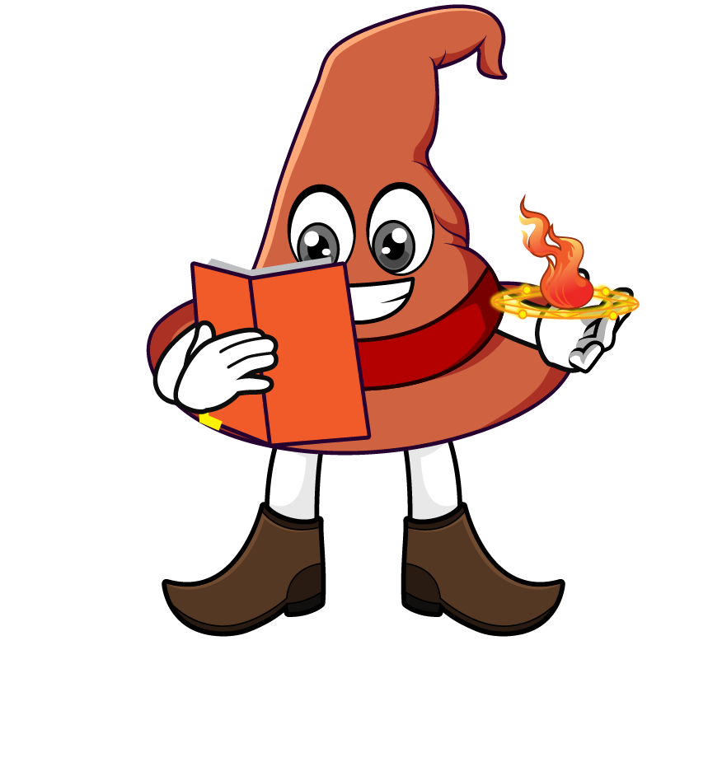
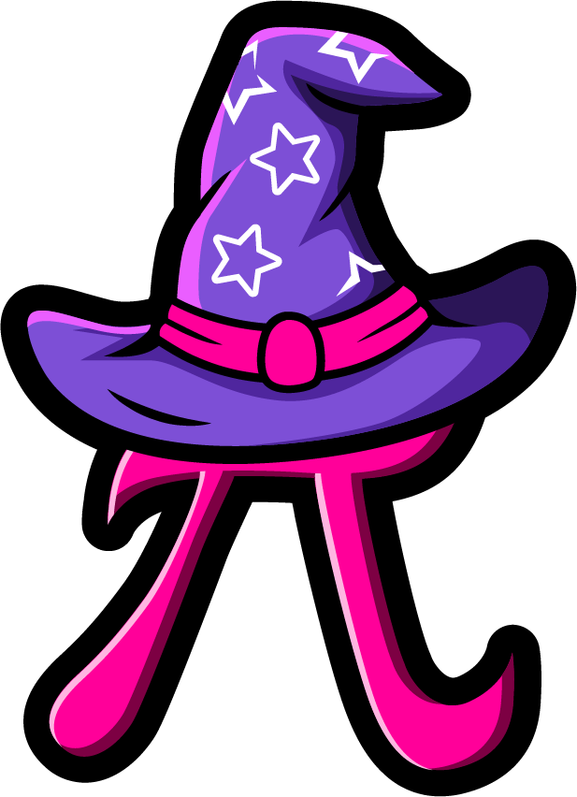
Lesson 4:
Multiply a tenth by a
multiple of 1000
www.arithmagicians.com

Slide 2

Which strategy do you prefer? Why?
0.7 x 6000
= 0.7 x 1000 x 6
= 700 x 6
= 4200
= 0.7 x 6 x 1000
= 4.2 x 1000
= 4200

Slide 3


Your Turn
A ribbon is 0.1 m long. What is the total length of 3000 ribbons placed end to end?
0.1 × 3000 = 300 m
2) A car travels 0.6 km in one minute. How far does it travel in 3000 minutes?
0.6 × 3000 = 1800 km
3) A flower grows 0.4 cm each day. How much does it grow in 8000 days?
0.4 × 8000 = 3200 cm

Slide 4
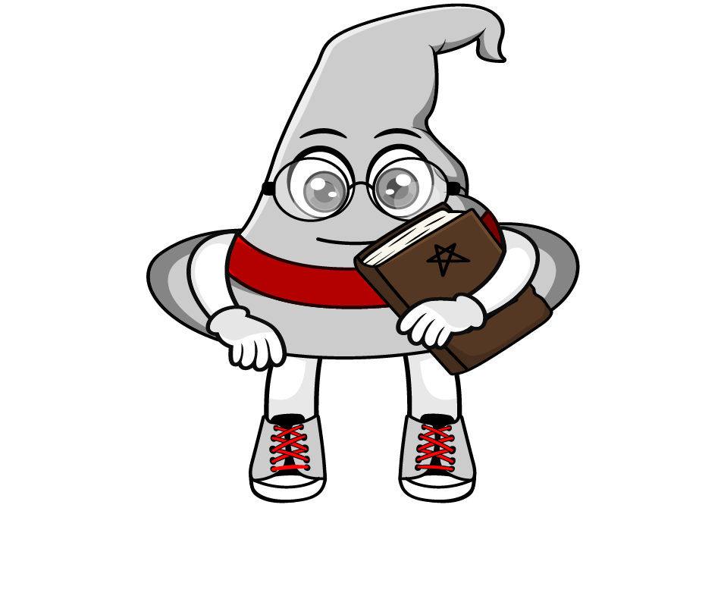
True or False
0.2 x 1000 = 0.2 x 10 x 100
True: Can you explain why?

